Slide 1
CCSSE 2021 Findings for Treasure Valley Community College
August 11, 2021
Administrative Team Summer Planning Meeting
Nino Kalatozi, PhD
Director of Institutional Effectiveness & Planning
Treasure Valley Community College

Slide 2
CCSSE Overview

Slide 3
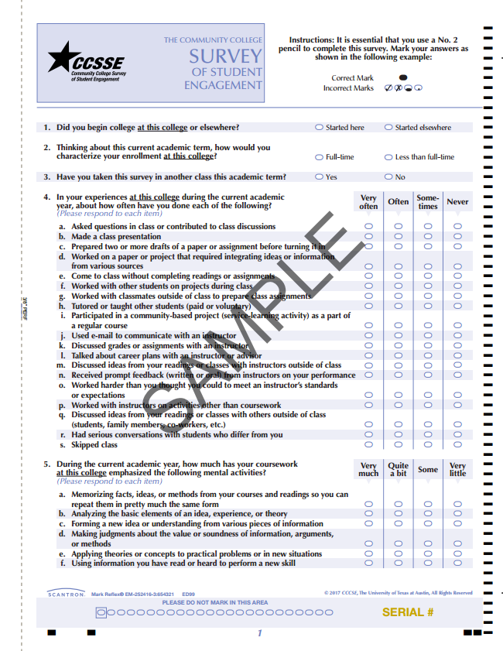
The Community College Survey of Student Engagement (CCSSE)
CCSSE is designed to capture student engagement as a measure of institutional effectiveness.

Slide 4
What is Student Engagement?
The amount of time and energy students invest in meaningful educational practices
The institutional practices and student behaviors that are highly correlated with student learning and retention

Slide 5
Student Respondent Profile at Treasure Valley Community College

Slide 6
Survey Respondents
150 adjusted survey count
14% overall “percent of target” rate
Targeted number of surveys 1078
Respondents marking invalid data selections were excluded
Source: 2021 CCSSE data

Slide 7
Student Respondent Profile:
Enrollment Status
Source: 2021 CCSSE data

Slide 8
Student Respondent Profile:
Age
Source: 2021 CCSSE data

Slide 9
Student Respondent Profile:
Gender Identity
Source: 2021 CCSSE data

Slide 10
Student Respondent Profile:
Racial/Ethnic Identification
Source: 2021 CCSSE data

Slide 11
Student Respondent Profile:
First-Generation Status
Source: 2021 CCSSE data

Slide 12
Student Respondent Profile:
Goals
Source: 2021 CCSSE data

Slide 13
Student Respondent Profile:
External Commitments
Source: 2021 CCSSE data

Slide 14
CCSSE Benchmarks

Slide 15
CCSSE Benchmarks for
Effective Educational Practice
  Active and Collaborative Learning
  Student Effort
  Academic Challenge
  Student-Faculty Interaction
  Support for Learners

Slide 16
CCSSE Benchmarks for
Effective Educational Practice
CCSSE Benchmark Scores for Treasure Valley Community College
Source: 2021 CCSSE data

Slide 17
CCSSE Benchmarks for
Effective Educational Practice
CCSSE Benchmark Scores for Treasure Valley Community College compared to 2021 Cohort and Small Colleges
Source: 2021 CCSSE data

Slide 18
Knowledge, Skills and Personal Development
How much has your experience at this college contributed to your
knowledge, skills, and personal development in the following areas?
Source: 2021 CCSSE data

Slide 19
College Support
How much does this college emphasize the following?
Source: 2021 CCSSE data

Slide 20
Student Persistence
Barriers to Returning to College
How likely is it that the following issues would cause you to withdraw from class or from this college?
Source: 2021 CCSSE data

Slide 21
Student Satisfaction – Academic Services
Academic Services | Somewhat or Very Satisfied | Somewhat Satisfied | Very Satisfied
Academic Advising/Planning | 90% | 34%; | 56%
Peer or other Tutoring | 89% | 33% | 55%
Skill Labs (Writing, Math, etc.) | 99% | 45% | 54%
Computer Lab | 99% | 40% | 59%
Transfer Advising/Planning | 82% | 53% | 29%
Library Resources and Services | 98% | 27% | 71%

Slide 22
Student Satisfaction – Student Support Services
Student Support Services | Somewhat or Very Satisfied | Somewhat Satisfied | Very Satisfied
Career Counseling | 99% | 61% | 38%
Job Placement Assistance | 94% | 71% | 23%
Child Care | 100% | 50% | 50%
Financial Aid Advising | 96% | 45% | 51%
Student Organizations | 97% | 42% | 56%
Services for Students with Disabilities | 100% | 53% | 47%
Services for Active Military and Veterans | 100% | 25% | 75%

Slide 23
Overall Experience
How would you evaluate your overall educational experience at this college?
Poor | 0.4%
Fair | 13.1%
Good | 48.9%
Excellent | 37.6%
Source: 2021 CCSSE data

Slide 24
Would you recommend this college to a friend or family member?
YES | 7.7%
No | 92.3%
Source: 2021 CCSSE data

Slide 25
Questions?

