Slide 1

TVCC Cybersecurity
Summer 2021 Training

Slide 2
Interesting facts
Cybercrime is up 600% due to the pandemic
98% of cyber attacks rely on social engineering
81% of organizations were affected by cybercrime last year
Third-party app stores hosts 99% of discoverable mobile malware
A malicious hacking attack occurs every 39 seconds
80% of all targeted attacks started with phishing scams
Higher education particularly vulnerable (transparency, legacy systems)
30% education industry users fell for phishing scams
94% of malware is delivered via email
$17,700 is lost every minute due to phishing attacks
60% of breaches involved vulnerabilities for which a patch was available but not applied

Slide 3
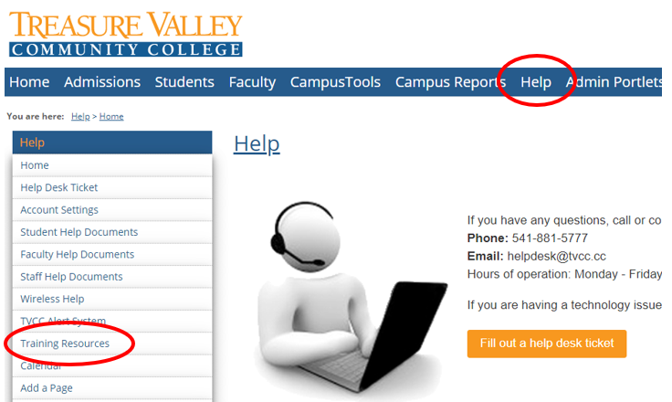
HOW TO FIND YOUR TRAINING?
Log into MyTVCC
Click “Help”
Click “Training Resources”

Slide 4
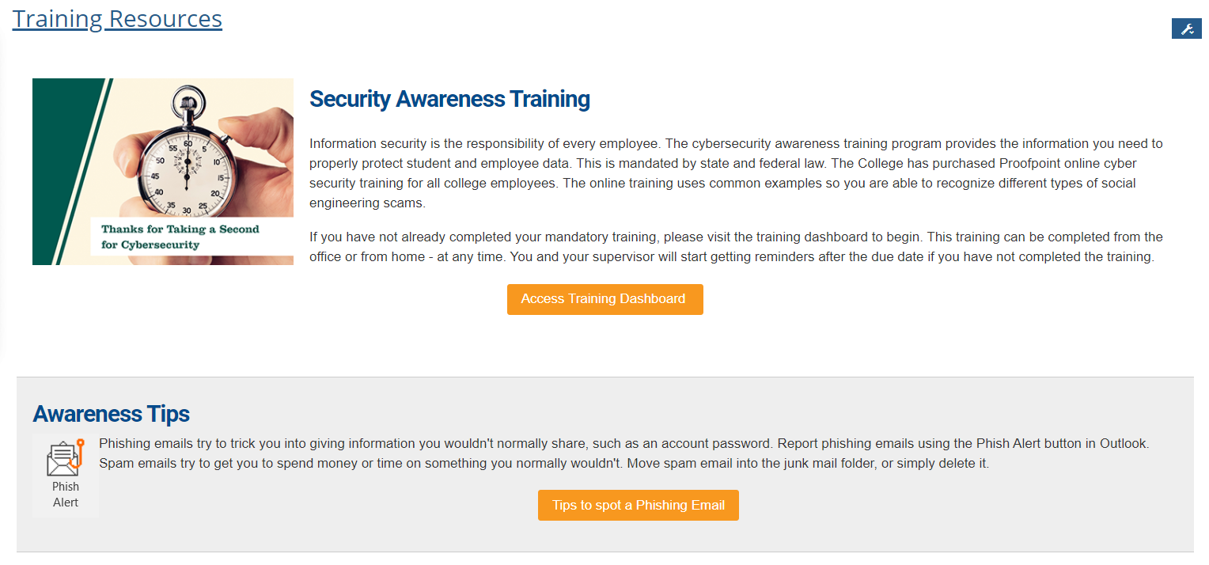
TRAINING resources

Slide 5
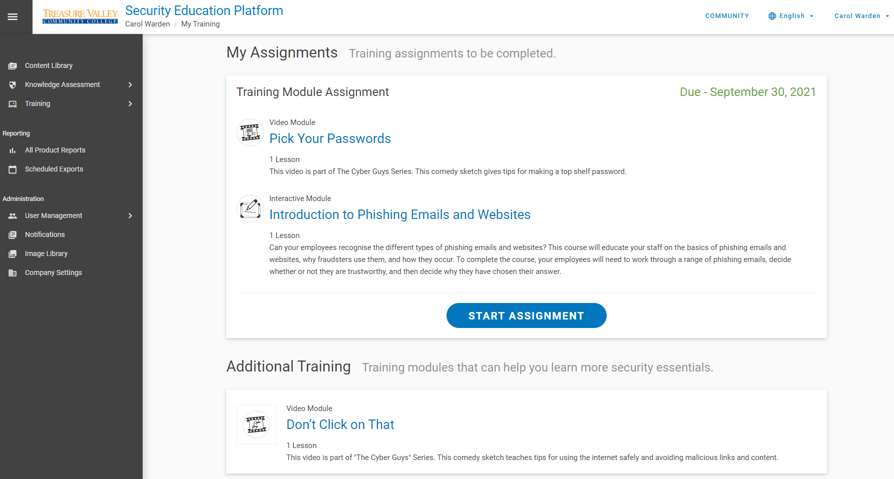
TRAINING resources

Slide 6

Tvcc best practices reminders
Lock your computer when you step away ( + L), virtually and physically
Do not save your passwords in the browser (use a password vault with a completely different password than anything else)
Keep your system up to date
Make backups
Use multi-factor authentication (MFA)
Encrypt your data and protect personal information
Use Virtual Private Network (VPN) or View for remote access
Limit activities on public WiFi
Slow down and evaluate emails carefully

Slide 7
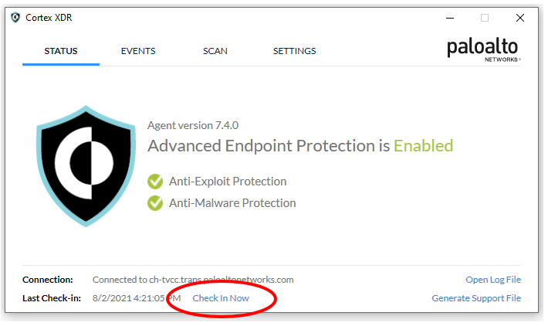
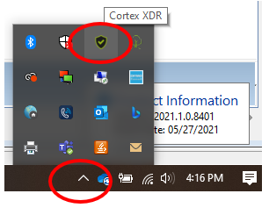
Cortex / anti-virus software
“Check-in” with Cortex XDR

Slide 8

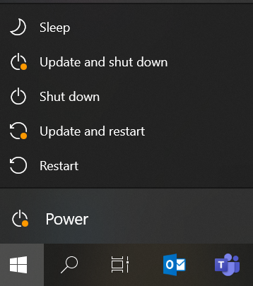
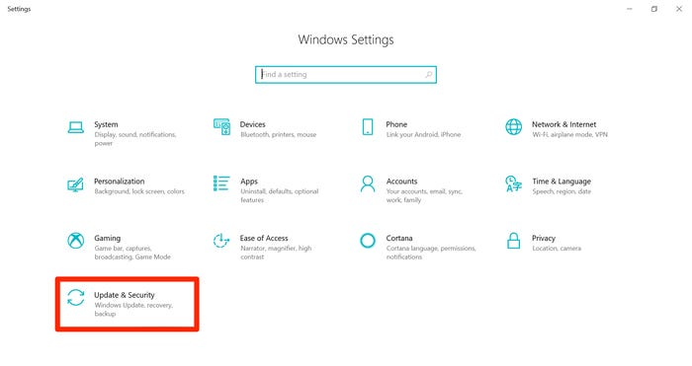
Keep your system up to date
Look for updates when you shutdown or restart.

Slide 9
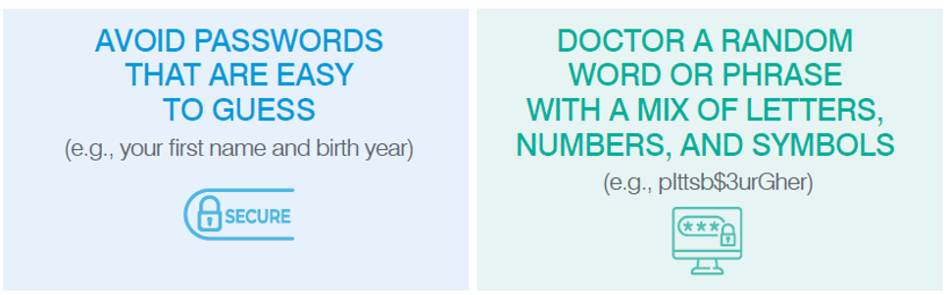
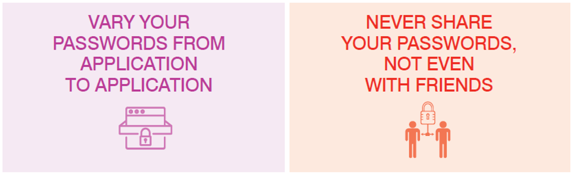
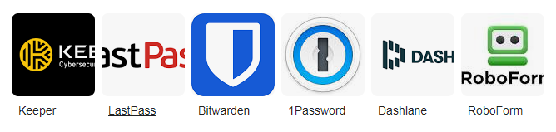
passwords
Use a password vault

Slide 10
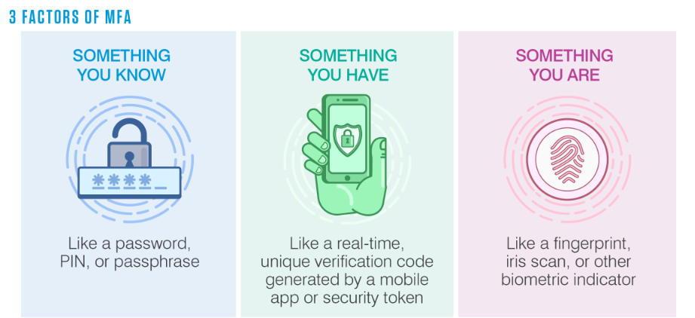
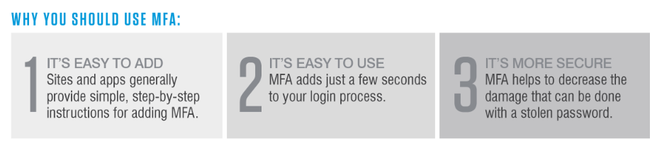
Multi-factor authentication (mfa)

Slide 11
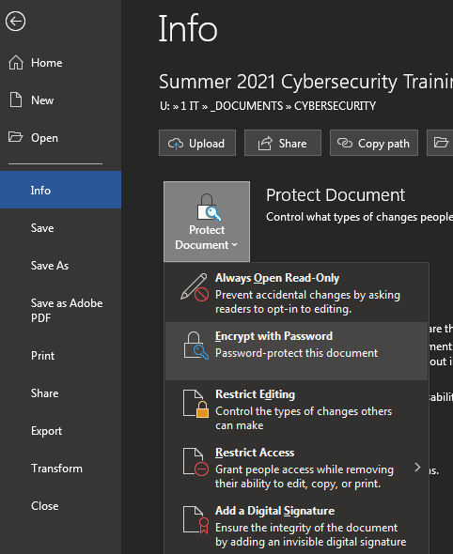
Password protect word documents
Go to File > Info > Protect Document > Encrypt with Password
Type a password, then type it again to confirm it
Save the file to make sure the password takes effect

Slide 12
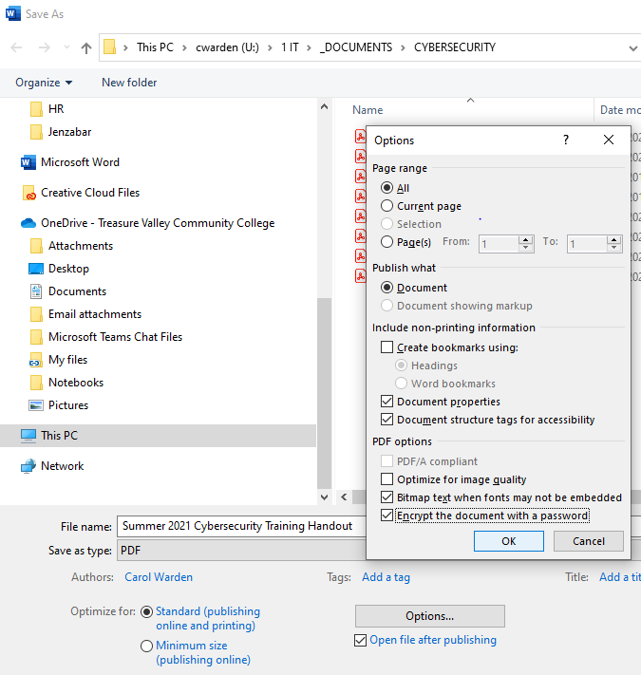
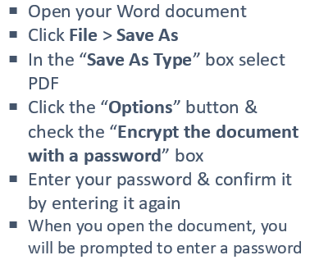
Password protect pdf documents

Slide 13
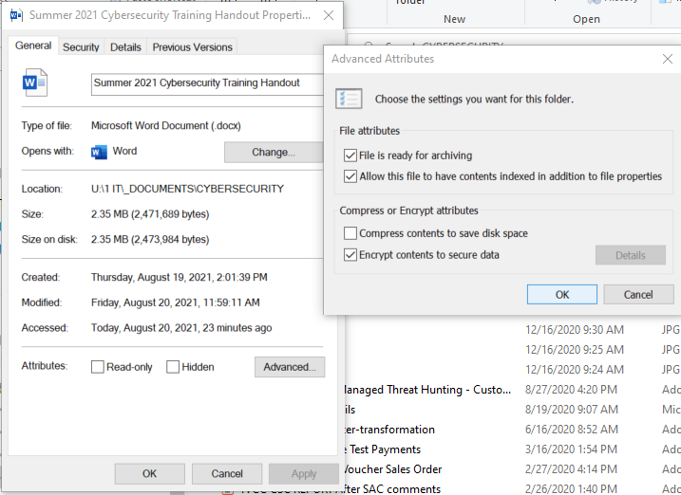
Encrypt a file or folder
Right-click a file or folder & select “Properties”
Select the “Advanced” button
Click the “Encrypt contents to secure data” box
Click the “Options” button & check the “Encrypt the document with a password” box
Enter your password & confirm it by entering it again
When you open the document, you will be prompted to enter a password

Slide 14
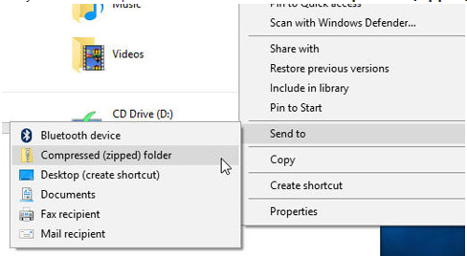
Zip files & folders
To Zip Files
Open File Explorer
Select the file or folder & right-click on it
Select “Send to > Compressed (zipped) folder”
UnZip Files
Entire Folder - right-click & select “Extract All” & follow the instructions
Single file or folder, double-click the zipped folder to open it, then drag or copy the item from the zipped folder to a new location

Slide 15
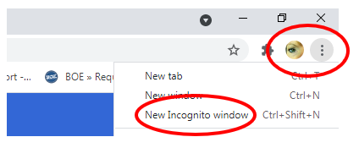
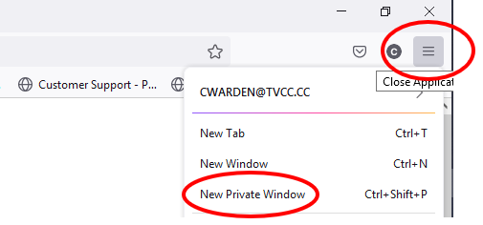
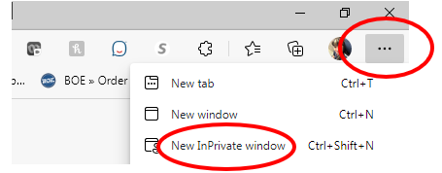
Use “incognito” browser mode
Google Chrome
Firefox
Microsoft Edge

Slide 16
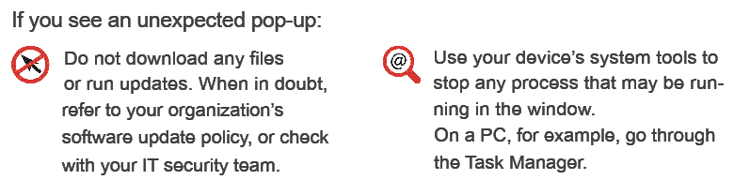
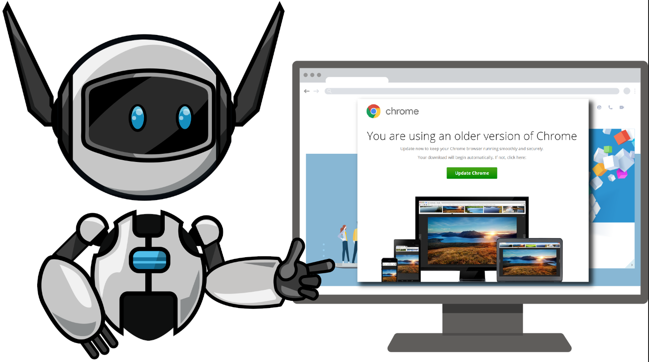
Fake browser updates
Only run software updates that come directly from a known, trusted source.

Slide 17
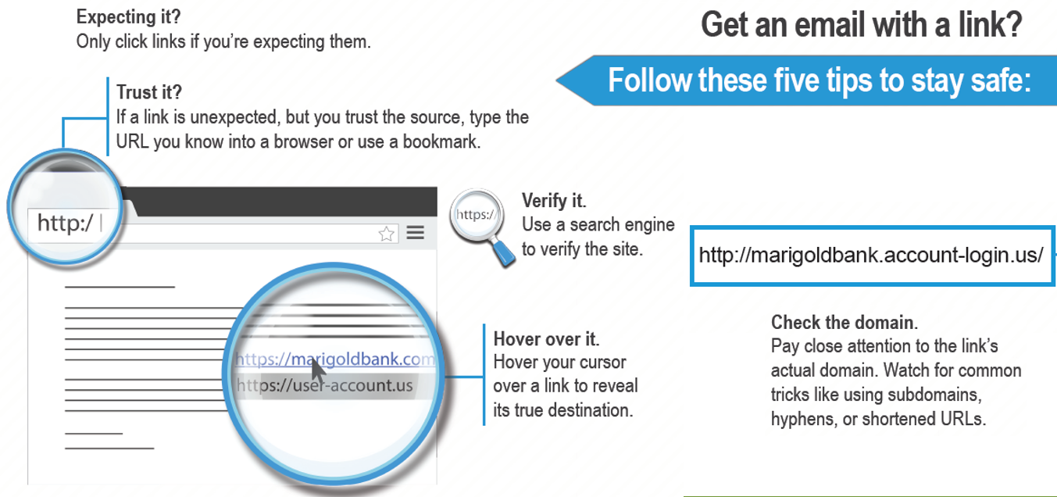
Avoid dangerous email links

Slide 18
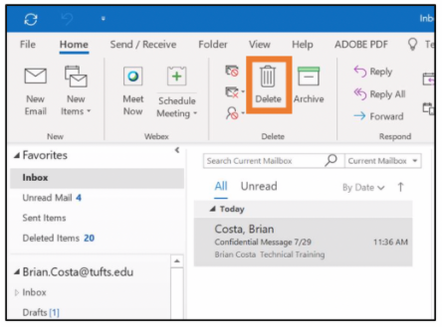
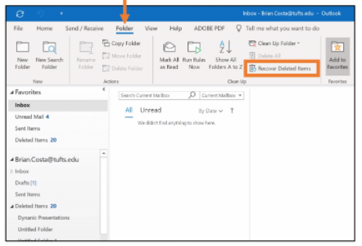

Deleting email from outlook
1. Open the Outlook desktop application.
2. Select the message(s) in your Inbox to be deleted. (If you previously deleted the message, you can find it in the Deleted Items folder.)
3. Hold down the Shift key on your keyboard and click Delete in the top control bar.
4. In the confirmation window that appears, click Yes. This will move the message to the Recoverable Items folder.
5. Select the Folder tab in the top menu.
6. Click Recover Deleted Items.
7. In the Recover Deleted Items window, select the message(s) you want to manage.
8. Select Purge Selected Items at the bottom of the window.
9. Click Ok
10. A warning will appear that you are about to permanently delete the selected messages and you will no longer be able to recover them. To proceed, click OK

Slide 19
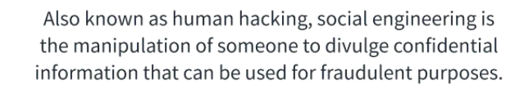
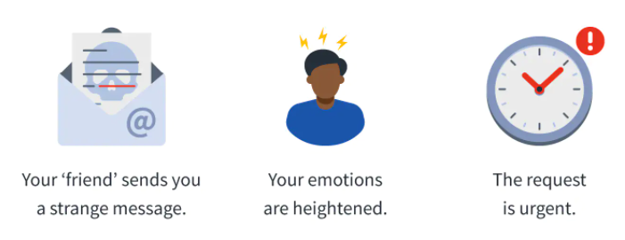
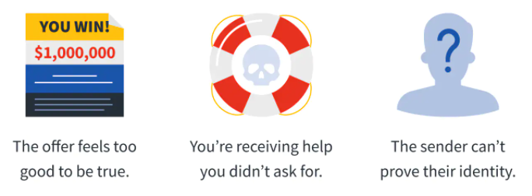
Social engineering explained
Knowing the red flags can help you avoid becoming a victim.

Slide 20
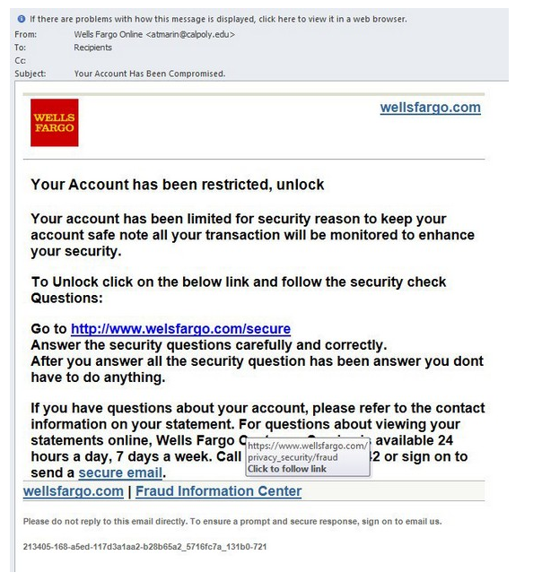
Real-life example
Oftentimes a social engineer will pose as someone from the IT department, calling a user with a fake problem (i.e. we had a social engineering scam going around and are asking users to reset their passwords). The bad actor offers a temporary solution (reset your credentials and set a temporary password like “1234” for now, then go in and reset it to what you want later). With the person’s username and new temporary password, the engineer gets into the account and resets it to something only they know— and has full access to their account seconds after the call.

Slide 21
Microsoft 365 phishing scam steals user credentials
In April 2021, security researchers discovered a Business Email Compromise (BEC) scam that tricks the recipient into installing malicious code on their device.
Here’s how the attack works.
  The target receives a blank email with a subject line about a “price revision.” The email contains an attachment that looks like an Excel spreadsheet file (.xlsx). However, the “spreadsheet” is actually a .html file in disguise.
  Upon opening the (disguised) .html file, the target is directed to a website containing malicious code. The code triggers a pop-up notification, telling the user they’ve been logged out of Microsoft 365, and inviting them to re-enter their login credentials.
  You can guess what happens next—the fraudulent web form sends the user’s credentials off to the cybercriminals running the scam.
This type of phishing—which relies on human error combined with weak defenses—has thrived during the pandemic.
Phishing rates doubled in 2020, according to the latest FBI data

Slide 22
5 ways to outsmart a social engineer
Don’t take things at Face Value
Ask Questions
Do your own Due Diligence
Don’t be afraid to say ‘No’
Allow yourself to be a little paranoid
https://www.youtube.com/watch?v=PWVN3Rq4gzw

Slide 23

Questions?

