Slide 1
Differences in JICS when the “New” Registration interface is turned on.

Slide 2
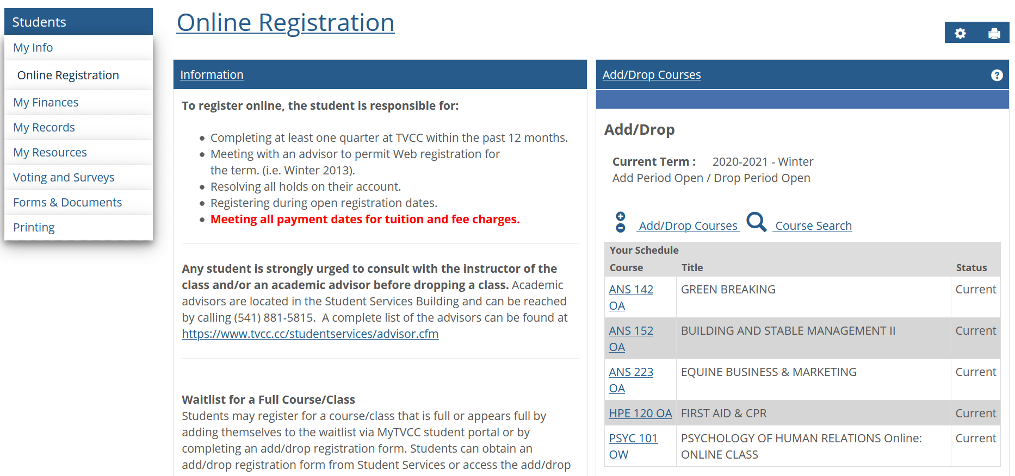
This is the current Online Registration page

Slide 3
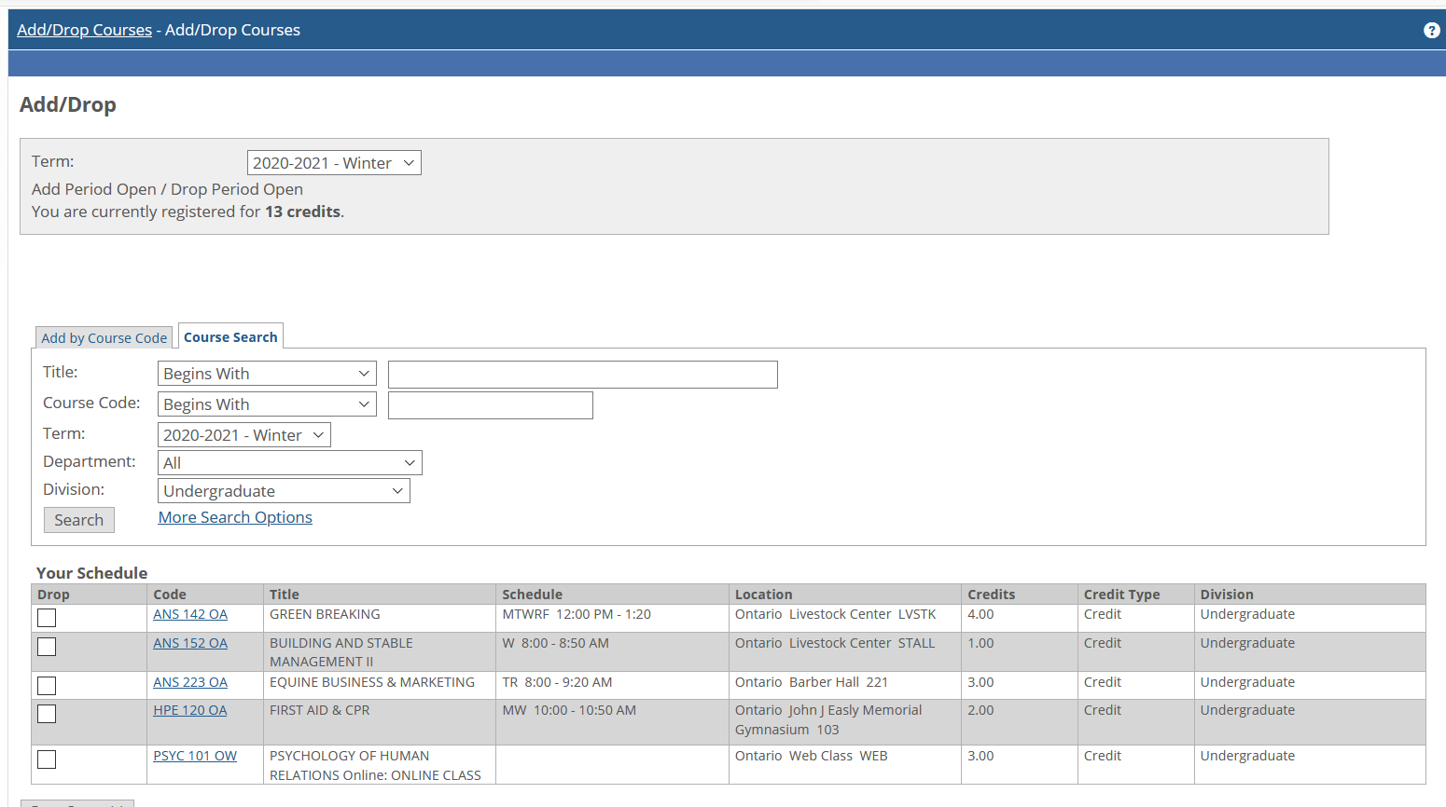
This is the current Add/Drop interface
Search for new classes here
Or Drop
Here

Slide 4
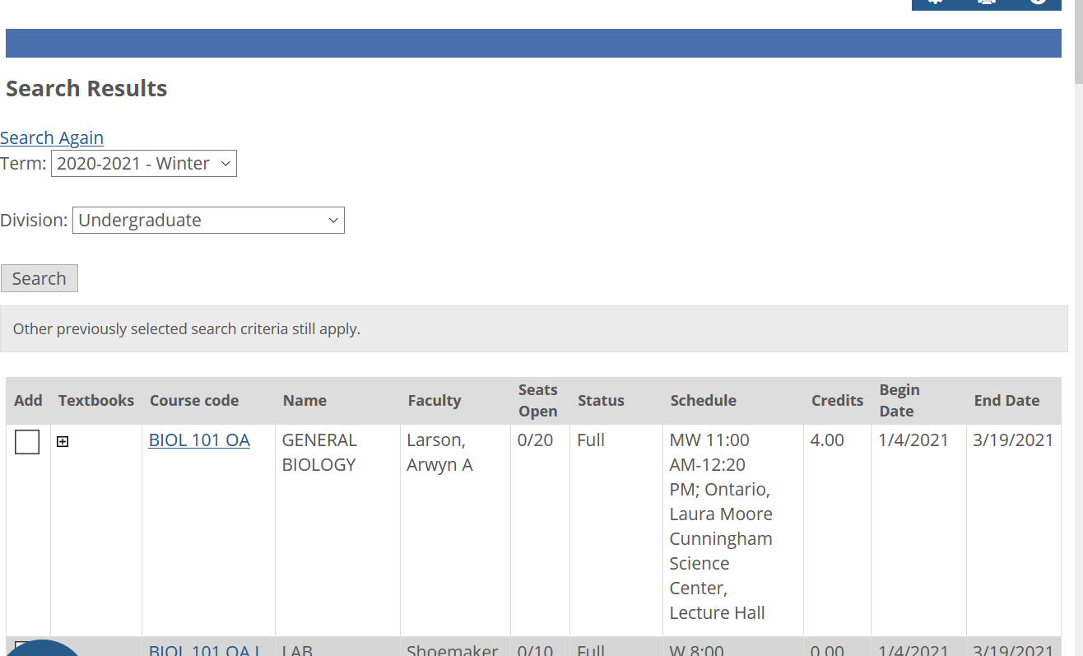
This is the Course Search tool on MyTVCC
If registration is open, you can add the course

Slide 5
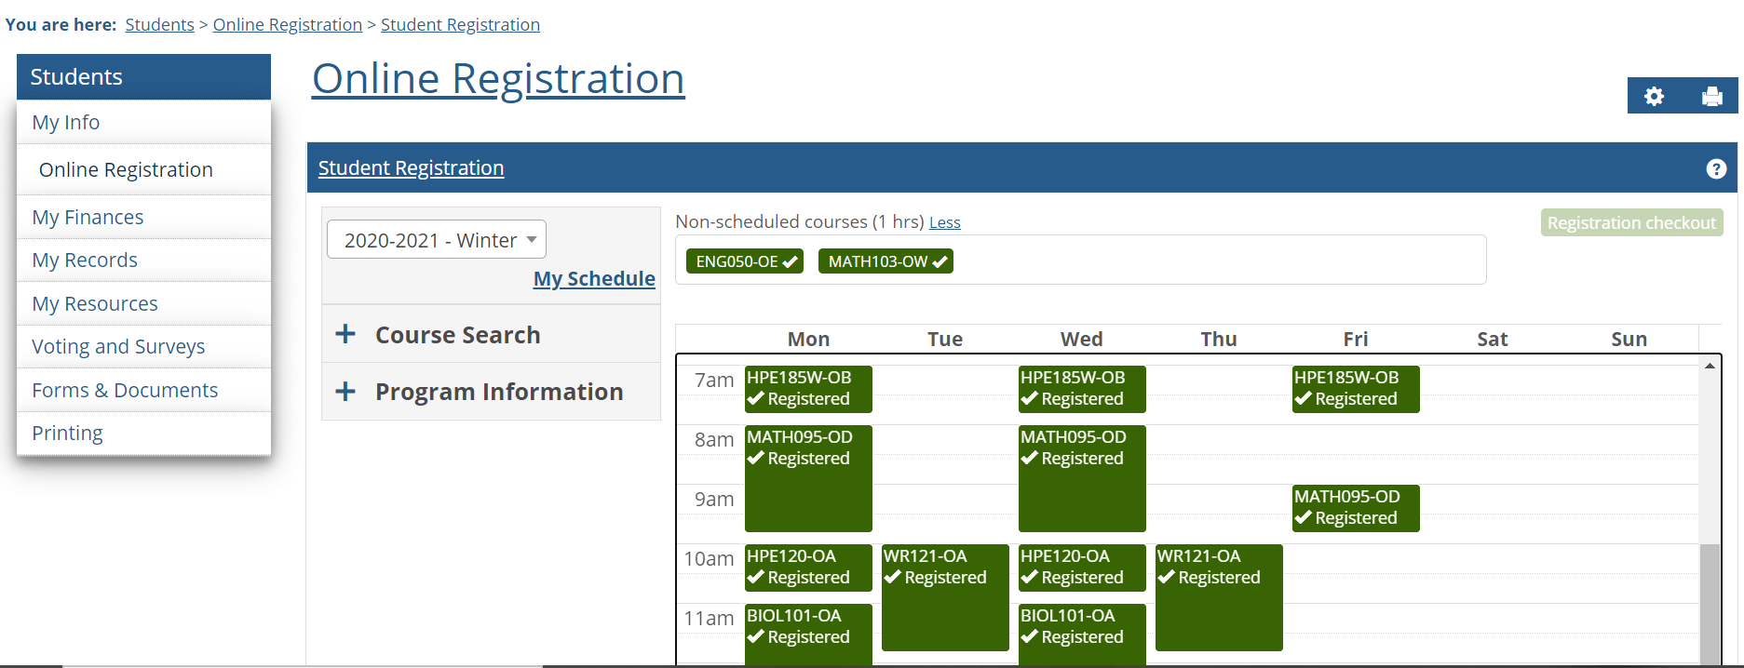
After the Switch, the Registration interface changes
New Registration tools
Our example student was already registered for classes

Slide 6
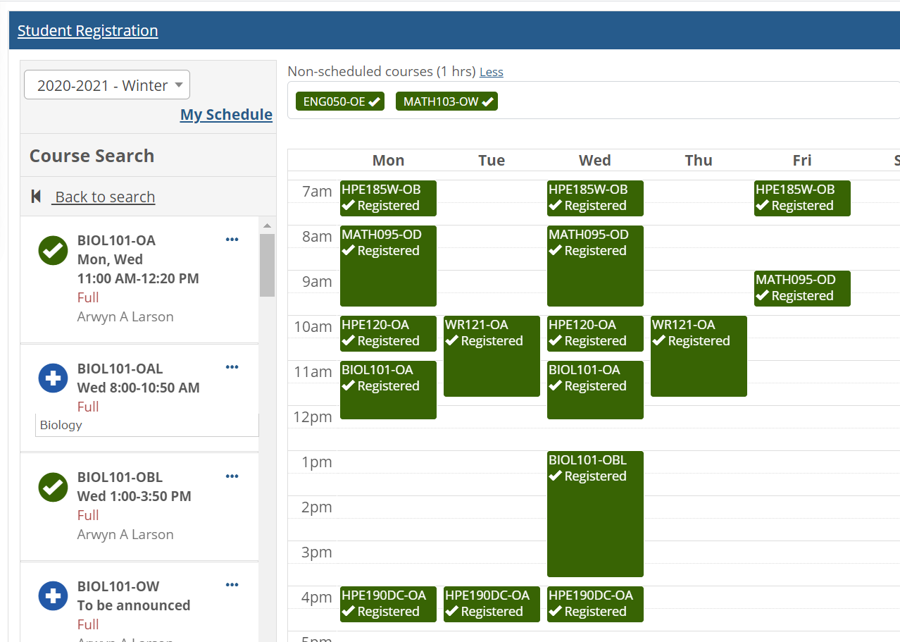
Without a plan, this is how a student adds courses
First, you search. In this case, Biology
Next, you select a section to register for, by clicking the Plus symbol. Once you’ve added the course, the plus becomes a check mark.

Slide 7
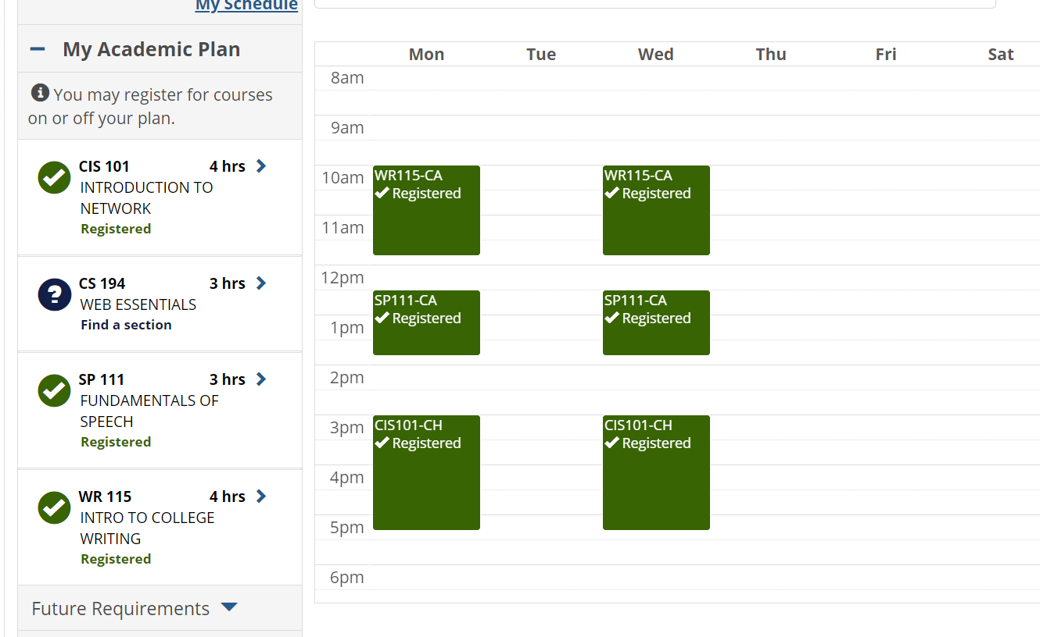
For a student WITH an academic plan
For students with an academic plan, the experience is different. They are shown a list of the courses which the plan expects them to take this term. They click a course to find a section that meets their needs and times.

