Slide 1
Accreditation
General Education Outcomes (Institutional Learning Outcomes) and
Program Outcomes

Slide 2
Accreditation
Original Recommendation
  Develop a consistent, systematic approach to mapping student learning outcomes at all levels and use the results of the assessment to improve instructional quality and learning. It is further recommended that the faculty and administration collaboratively develop a systematic and consistent approach to assessing student learning outcomes at the general education, program, and course level. Such an approach should:
  a. train faculty in defining and assessing student learning outcomes at all levels and across all departments, and
  b. develop consistent reporting and follow-up mechanisms that demonstrate how the results of student learning assessment inform the planning process and subsequently improve instruction and contribute to mission fulfillment (ER 11, ER 22, and Standard2.C.1, 2.C.3, and 2.C.5).
Revised Recommendation
Recommendation 1:
Fall 2018 Mission Fulfillment and Sustainability - Remains as Non-Compliant and timeline extended for good cause to come into compliance in Fall 2021
o Revised Recommendation 1: Fall 2018 Mission Fulfillment and Sustainability -Engage in an effective system of assessment and use the results of its assessment efforts to inform academic and learning-support planning and practices to continuously improve student learning outcomes (2020 Standard 1.C.5 and 1.C.7).

Slide 3
General Education Outcomes
(ILO’s)
General Education Outcomes / Institutional Learning Outcomes (ILO):
The Institutional Effectiveness Committee met to discuss ILO’s during the 2019-20 school year, as well as review the data, available from 2018-19.
The main take away from those discussions were two main concerns.
Number of assessments obtained and
The concern for continual faculty training to help ensure inter-rater reliability, in order to ensure accurate data.
For the 2019-20 year, a goal was set of 1400 assessments in Quantitative Reasoning and we achieved 1199 assessment points. Quantitative Reasoning was selected based on the fact the data showed the lowest scores and a low number of assessments.
The result was in increase to 1199 assessments, slightly below our institutional goal, but a significant increase from the prior year.

Slide 4
General Education Outcomes
(ILO’s)
General Education Outcomes / Institutional Learning Outcomes (ILO):
Gen Ed Assessments – All Assessments from 2019-20
  Review of Data
  Review Findings
Gen Ed Assessments – Assessments of Completers Only (during 2019-20)
  Review of Data
  Review Findings

Slide 5
General Education Outcomes
(ILO’s)
Gen Ed Assessments –
All Assessments from 2019-20

Slide 6
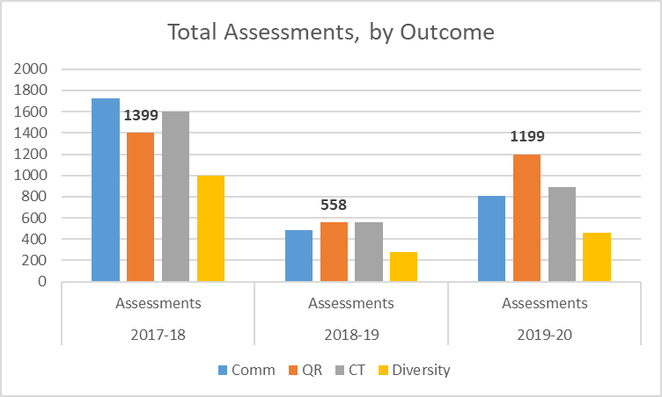

Slide 7
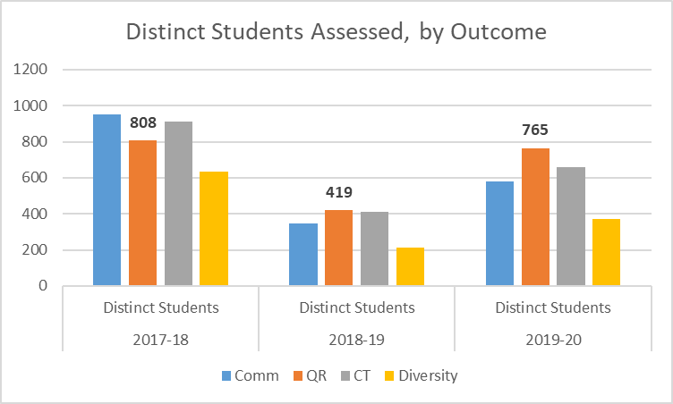

Slide 8
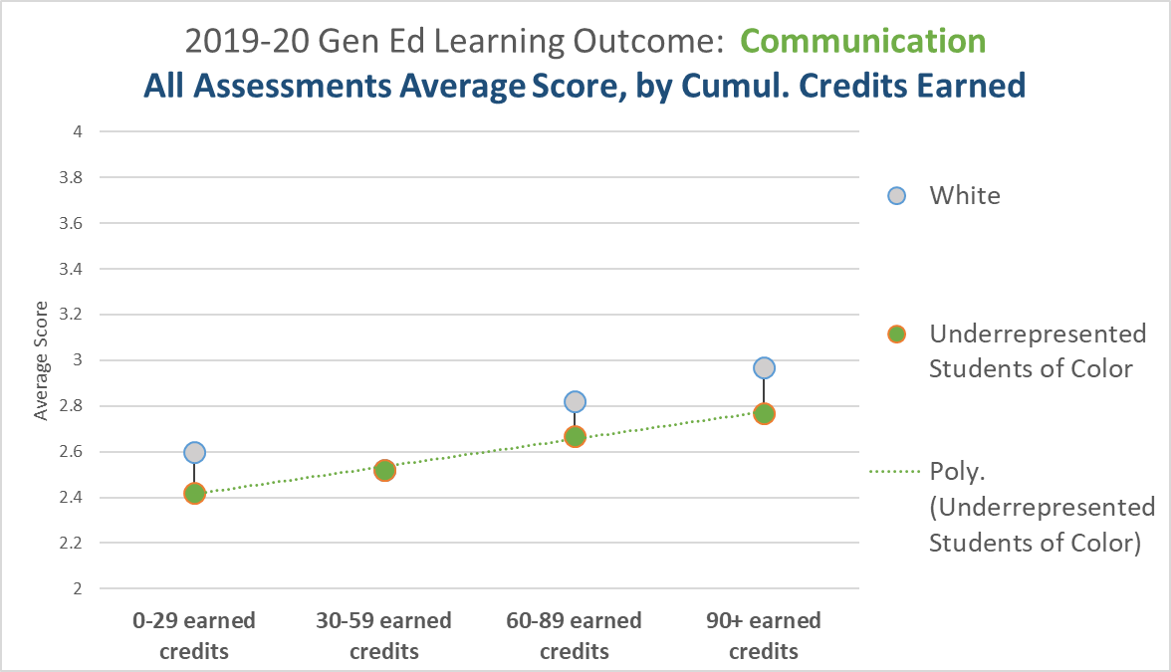
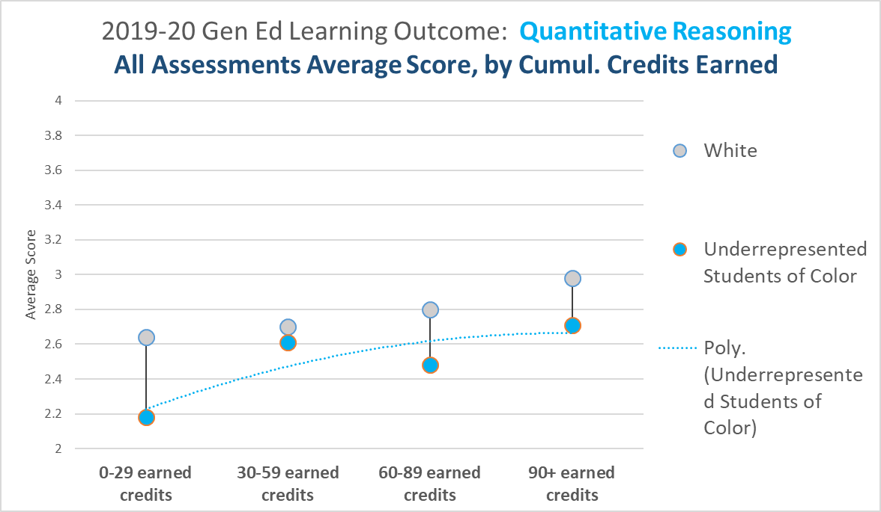
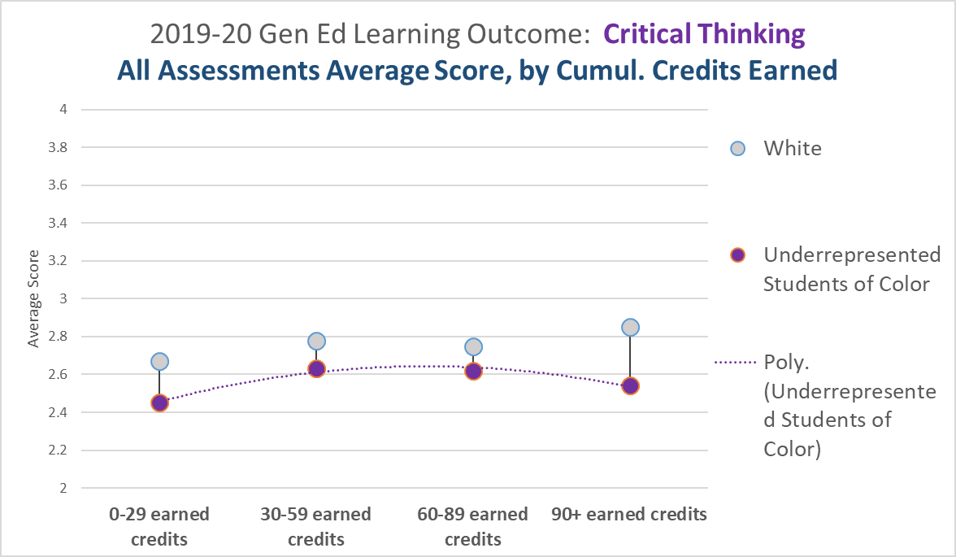
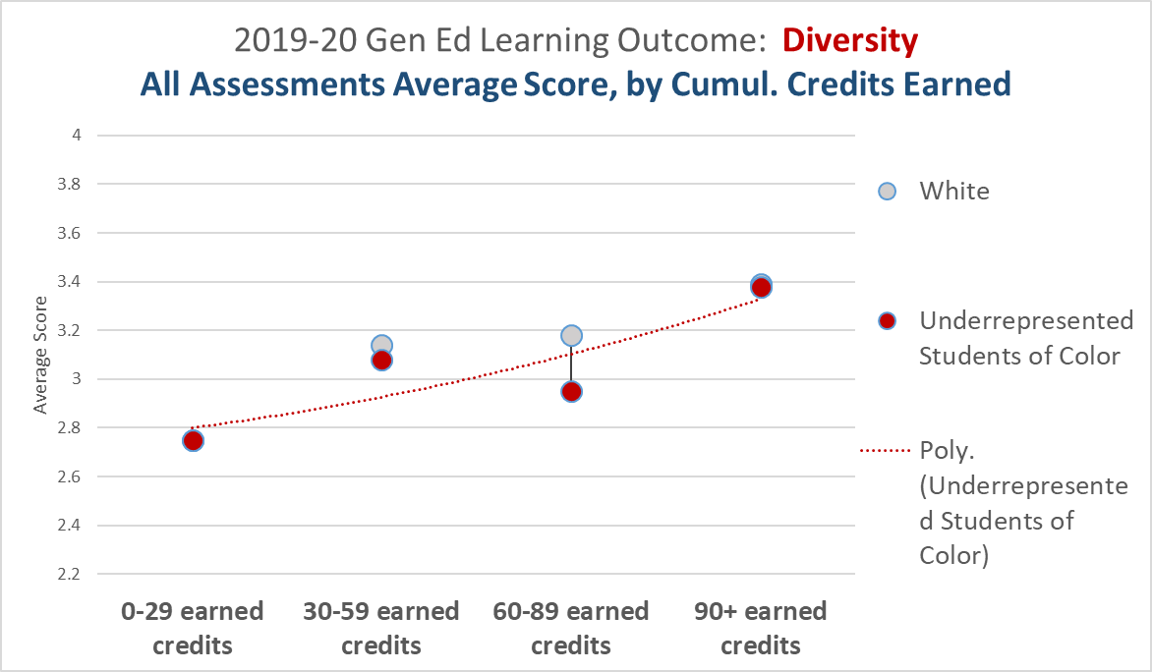
How did Underrepresented Student of Color (USOC) fare?

Slide 9
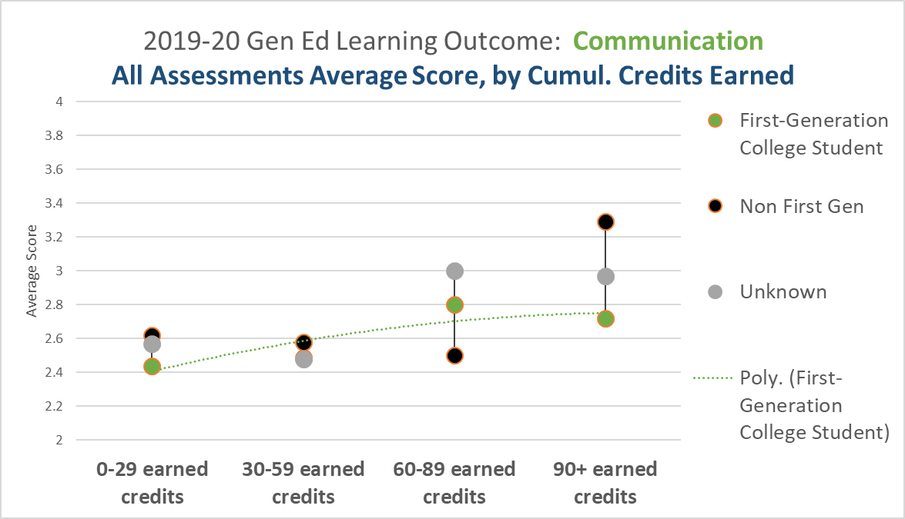
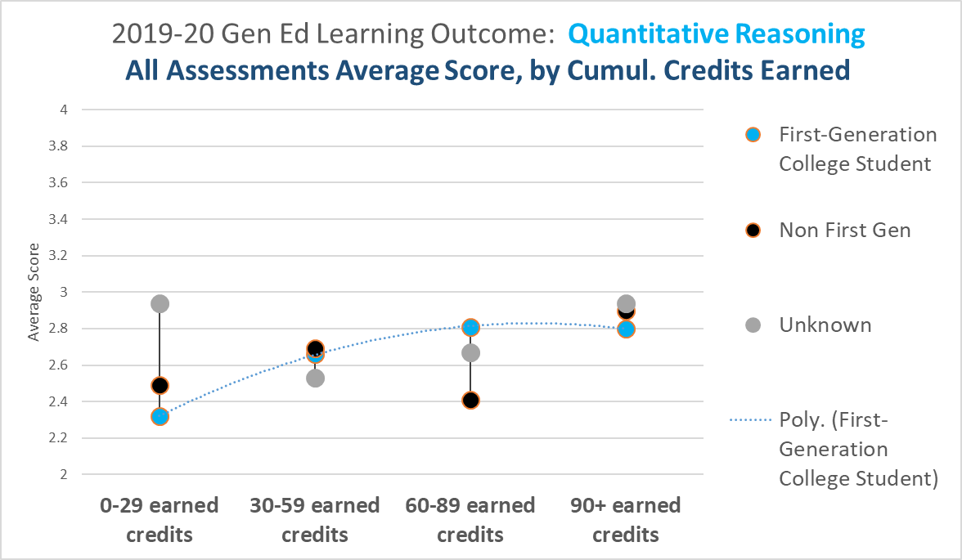
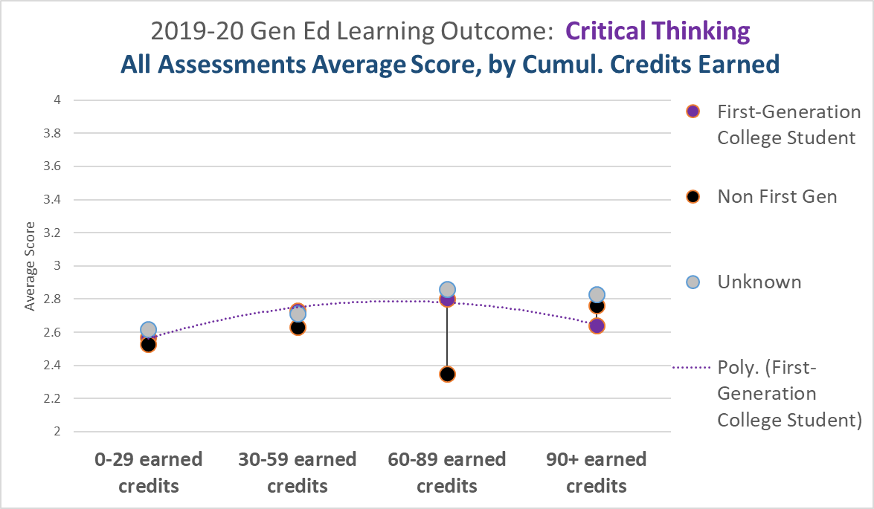
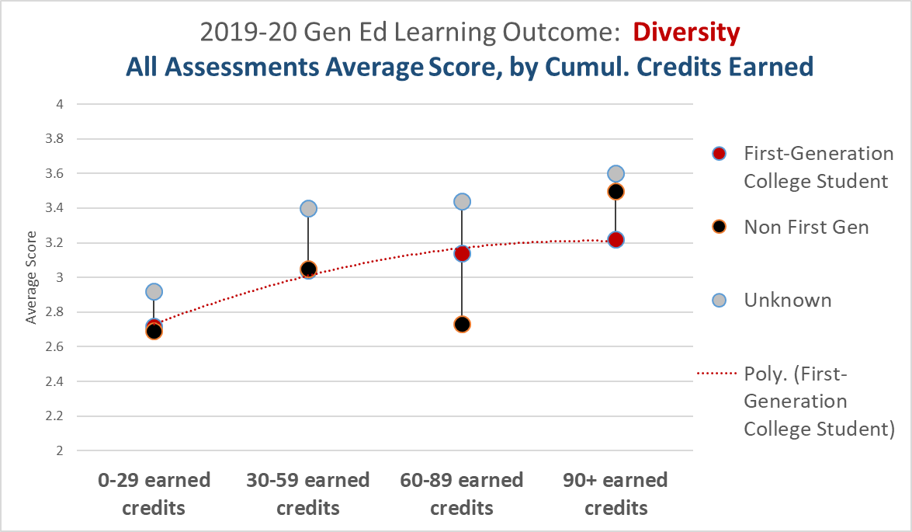
How did First-Generation College Students fare?

Slide 10
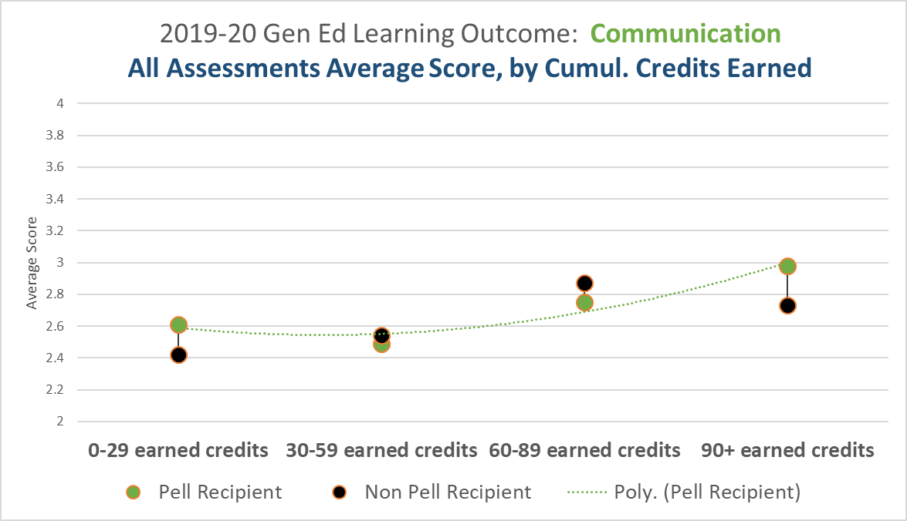
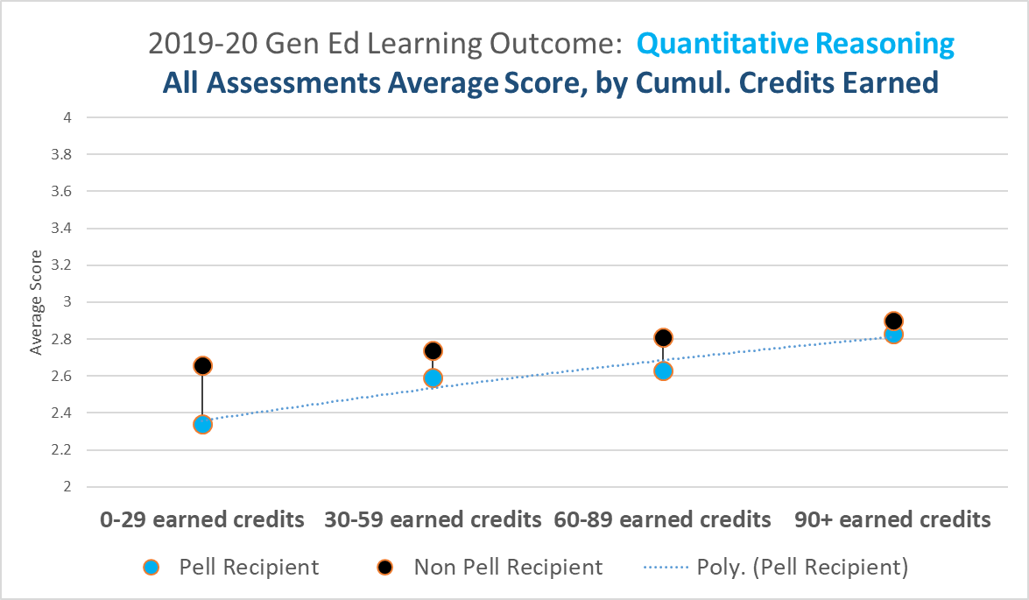
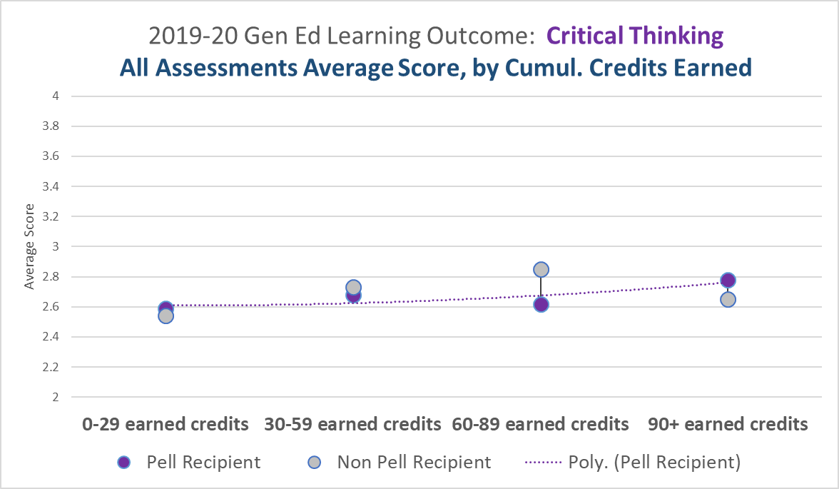
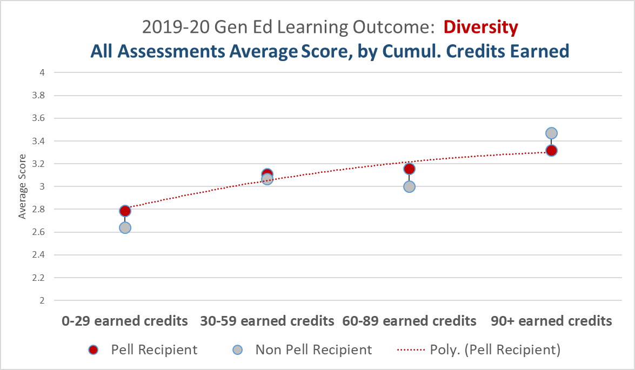
How did Economically Disadvantaged Students fare?

Slide 11
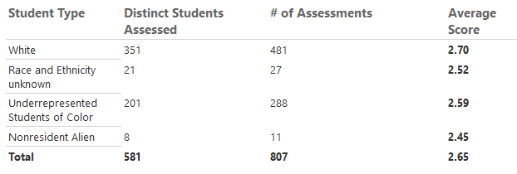
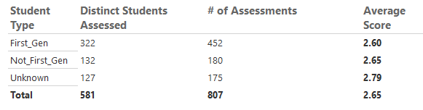
Communication: 2019-20 n’s by Equity Lens

Slide 12
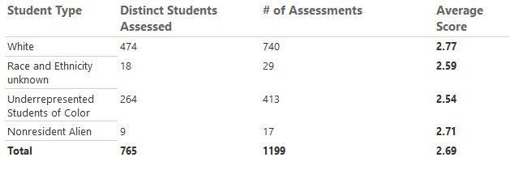
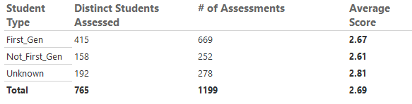
Quantitative Reasoning: 2019-20 n’s by Equity Lens

Slide 13
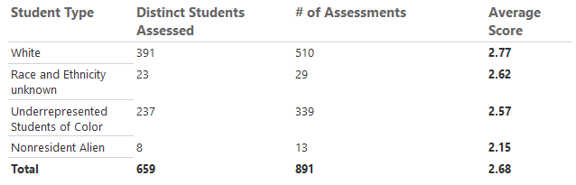
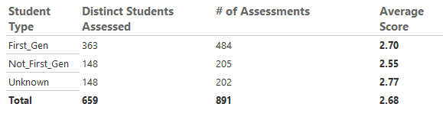
Critical Thinking: 2019-20 n’s by Equity Lens

Slide 14
Findings
For 2019-20, we had a goal of 1,400 total assessments in QR. As of 7/22/2020, we had 1,199 QR Assessments for the year.
As students earned more credits…
  USOC fared lower than White students in Comm, QR, and CT.
  USOC and First-Gen trended flat-downwards in CT.
  First-Gen students fared well in QR, compared to non-first-gen, but still many in the ‘Unknown’ group.
  Economically Disadvantaged students trended flat in CT, but not much disparity between their counterpart.

Slide 15
General Education Outcomes
(ILO’s)
Gen Ed Assessments –
Assessments of Completers Only

Slide 16
Results of 2019-20 General Education Learning Outcomes Assessments
New SSRS Reports Available
  Communication https://reports.tvcc.cc/Reports/report/Public/Gen_Ed_Outcomes_v2_Comm
  QR https://reports.tvcc.cc/Reports/report/Public/Gen_Ed_Outcomes_v2_QR
  CT https://reports.tvcc.cc/Reports/report/Public/Gen_Ed_Outcomes_v2_CT
  Diversity https://reports.tvcc.cc/Reports/report/Public/Gen_Ed_Outcomes_v2_DIV

Slide 17
2019-20 General Education Learning Outcomes: Methods
New Queries that Use Logic to Create a Single Flat File for Each ILO
One Unique Record for Every Assessment (this is the baseline for each dataset)
  So if Dave is in 6 courses over the year, and has 2 Comm Assessments and 1 CT Assessment, there are 2 records for Dave in the Comm flat file and 1 record for Dave in the CT flat file.
  Then, attributes are populated for each record. Attributes include: first-gen; race and ethnicity; Pell recipient status; cumulative credit hours earned at the end of the academic year; and 2-year degree completer within the academic year.

Slide 18
2019-20 General Education Learning Outcomes: Methods
  First-Gen data is pulled from Salesforce (Enrollment RX). Unfortunately, this data only goes back a couple of years at this point. And, not all students are necessarily in the recruiting system.. (Completers generally take between 2-3 years, so most are not in Salesforce database)
  Therefore, for records that are ‘NULL’ in this field after populating from Salesforce, we pull similar info from Powerfaids to populate the First-Gen field.
  Unfortunately, we are missing many values for First-Gen (i.e., there are many ‘Unknowns’) from previous years – and we expect the dataset to be more complete, each subsequent year.
  All Assessments are summed, then divided by the number of assessments. So if Dave was a “2-Year Completer” during the year, and his 2 Comm scores were a ‘2’ and a ‘3’, the effect of this method provides an average score of 2.5 for Comm for Dave.
  However, no individual students scores are available – these are all provided in disaggregated data only.

Slide 19
2-Year Completers
Only includes assessments of students who earned a 2-Year degree during the respective academic year.
This is an important way to view the data, as we expect that all students, regardless of their discipline or degree, would improve their abilities in our 4 ILOs after their academic journey at TVCC.

Slide 20
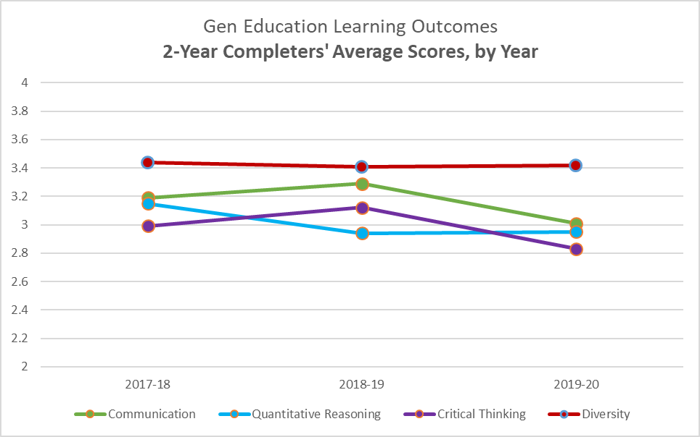

Slide 22
2-Year Completers
Next, we will look at these results through our three Equity Lenses.
Starting with ILO – Communication, by:
  Underrepresented Students of Color (USOC)
  First-Generation College Students
  Economically Disadvantaged Students (Pell Recipients)

Slide 23
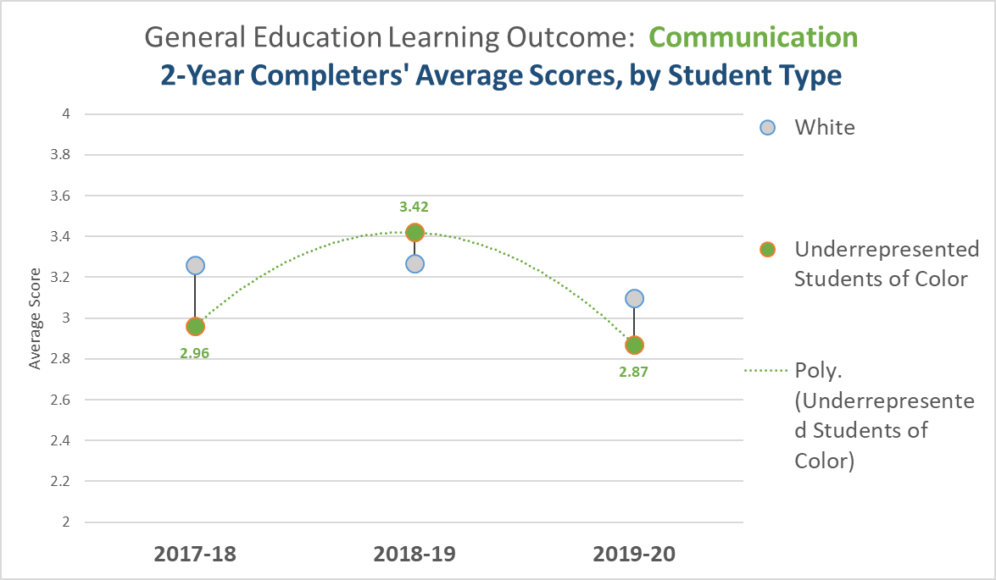

Slide 24
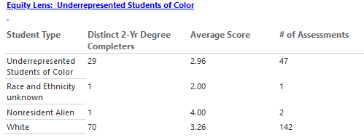
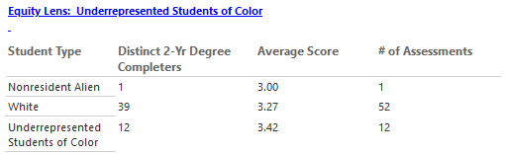
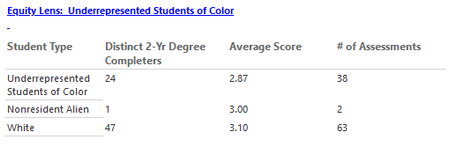
n’ s for 2017-18
n’ s for 2018-19
n’ s for 2019-20

Slide 25
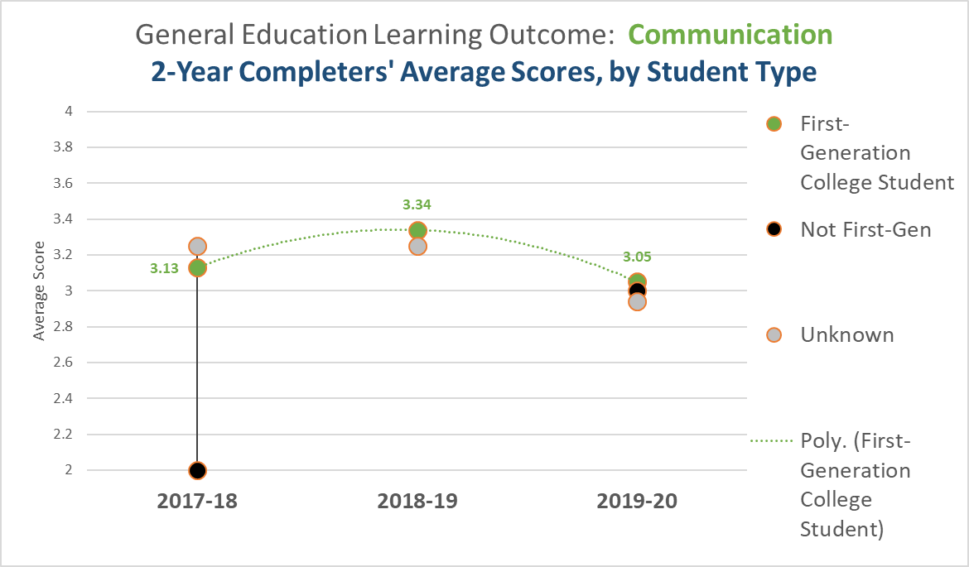

Slide 26
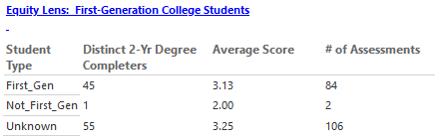
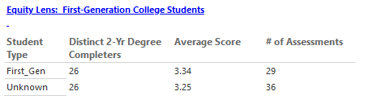
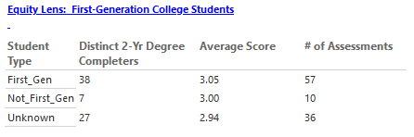
n’s for 2017-18
n’s for 2018-19
n’s for 2019-20

Slide 27
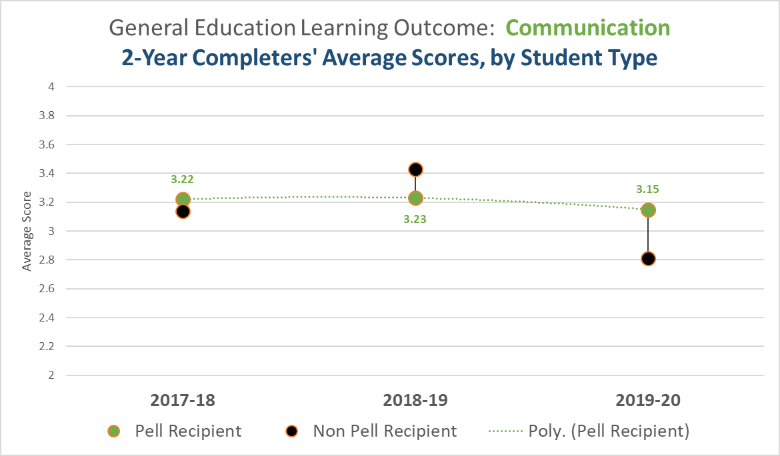

Slide 28
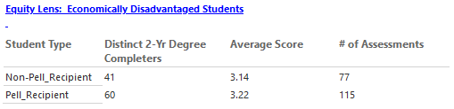
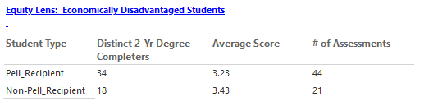
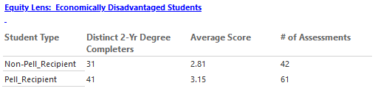
n’s for 2017-18
n’s for 2018-19
n’s for 2019-20

Slide 29
2-Year Completers
Next, ILO – Quantitative Reasoning, by:
  Underrepresented Students of Color (USOC)
  First-Generation College Students
  Economically Disadvantaged Students (Pell Recipients)

Slide 30
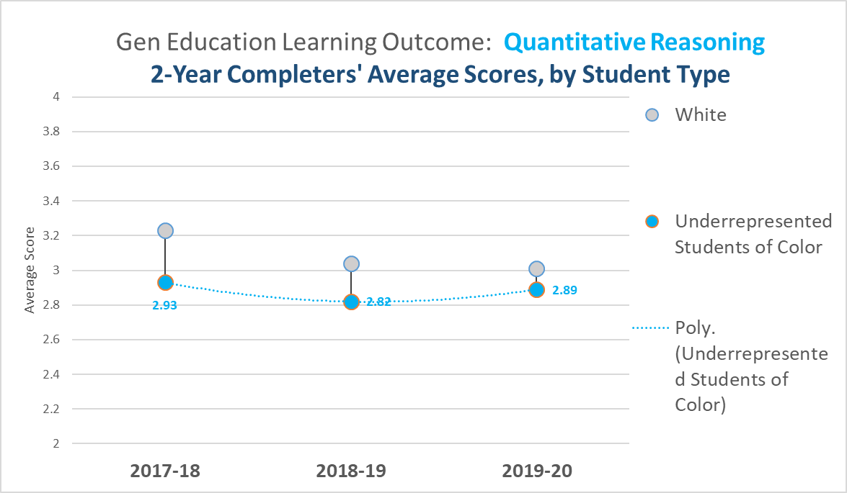

Slide 31
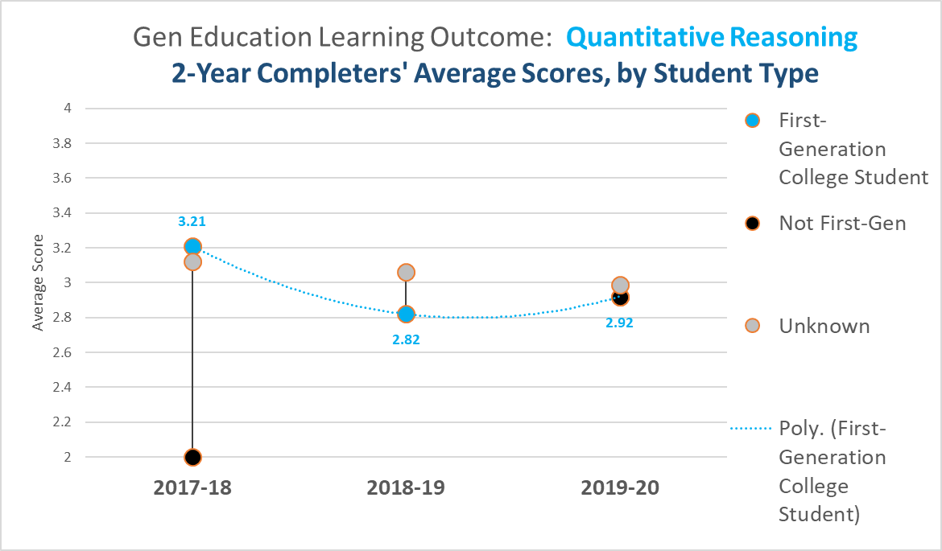

Slide 32
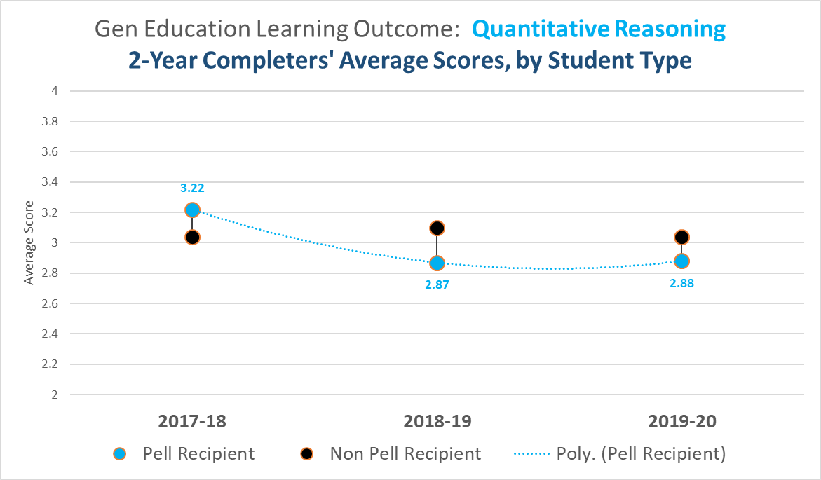

Slide 33
2-Year Completers
Next, ILO – Critical Thinking, by:
  Underrepresented Students of Color (USOC)
  First-Generation College Students
  Economically Disadvantaged Students (Pell Recipients)

Slide 34
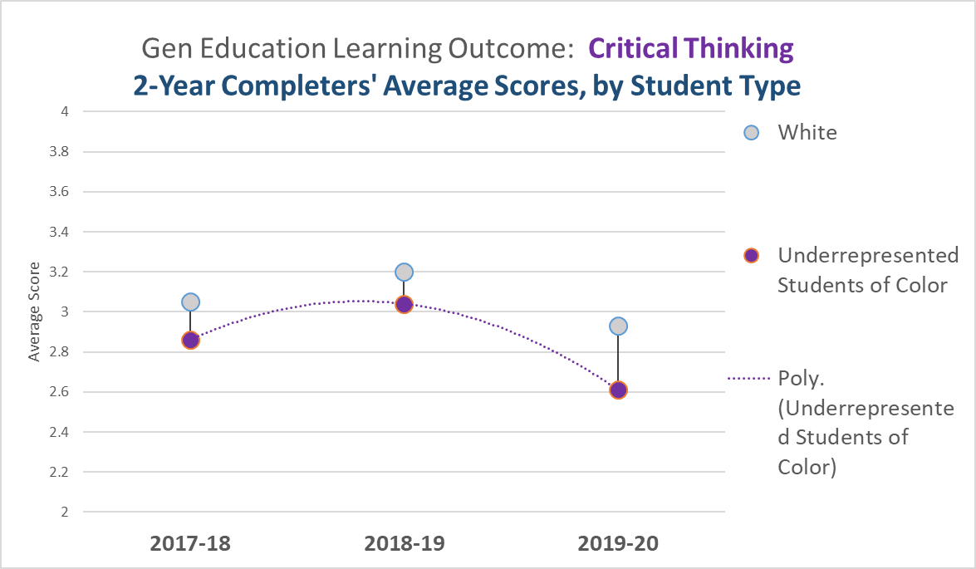

Slide 35
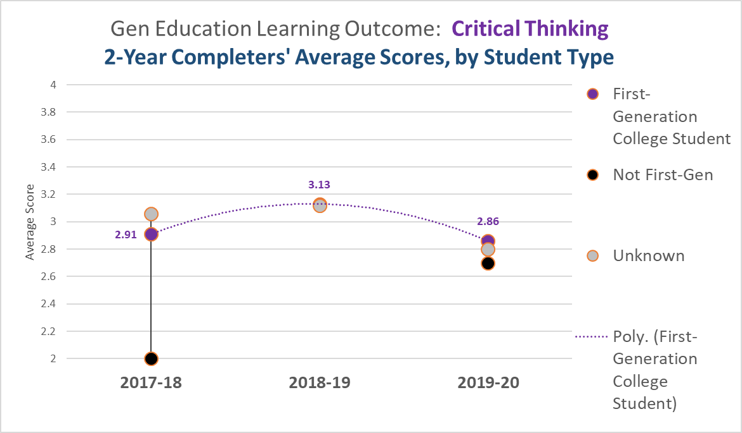

Slide 36
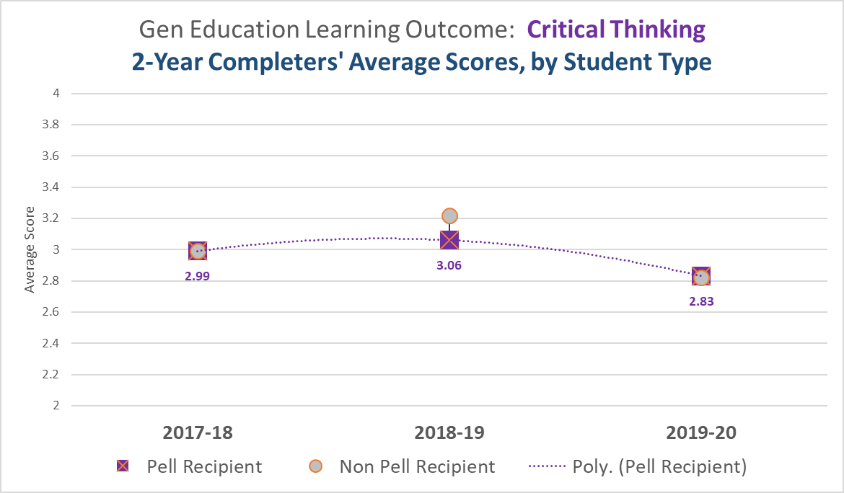

Slide 37
2-Year Completers
Finally, ILO – Diversity, by:
  Underrepresented Students of Color (USOC)
  First-Generation College Students
  Economically Disadvantaged Students (Pell Recipients)

Slide 38
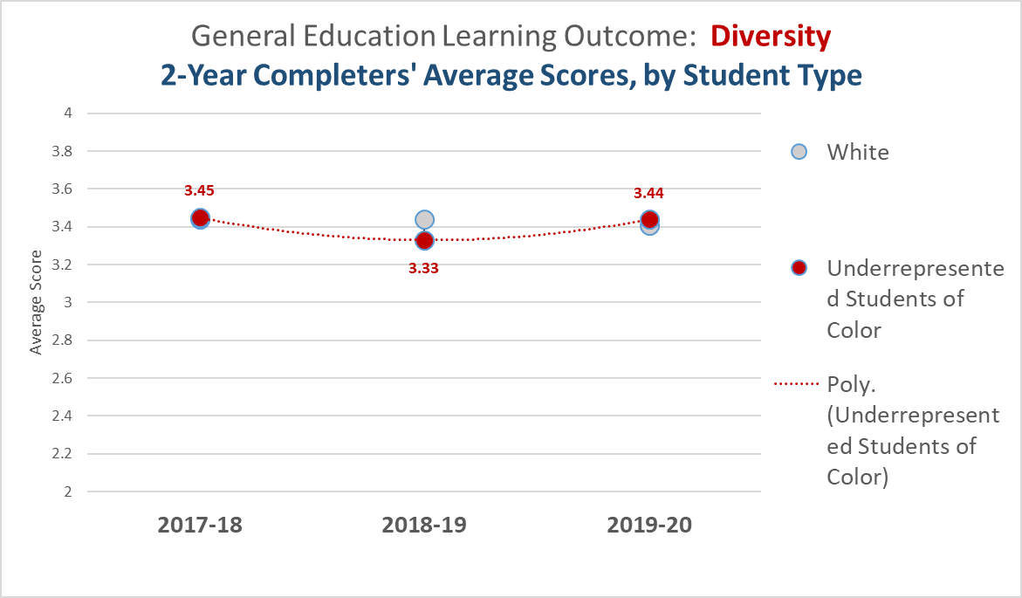

Slide 39
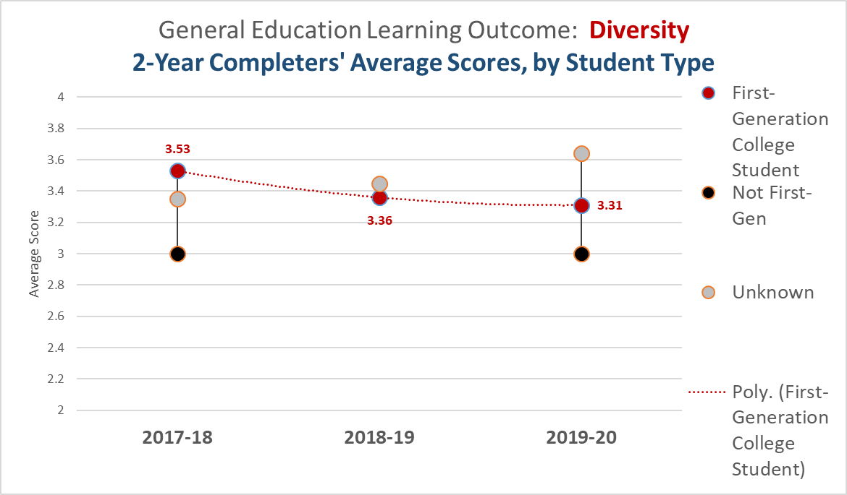

Slide 40
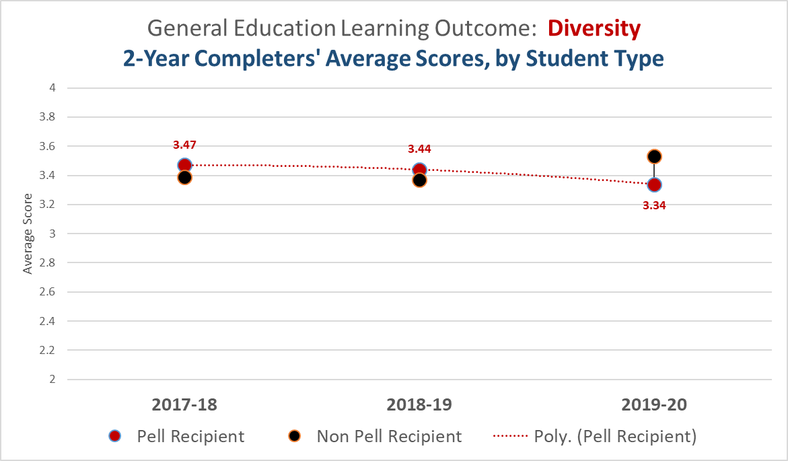

Slide 41
Findings: 2-Year Completers
Lowest Overall Score for 2019-20 is Critical Thinking (2.83).
  Communication (3.01) also took a similar drop, but the average score is higher than CT.
  QR was the penultimate average score, at 2.95.
In 2019-20, our focus for assessments, including faculty training, was on QR.
Isolating Communication, USOC fared the worst of the three Equity Lens student groups. 2019-20 saw the widest gap between Pell vs. non-Pell recipients.
QR looks to be trending upward by the disparate student groups, from last year.

Slide 42
Findings: 2-Year Completers
Looking at CT, the worst curve is by USOC.
In both Communications and CT, USOC trended downwards AND performed worse than White students.
In both Communications and CT, the curve is trending downwards for First-Gen students. First-gen dataset must be more complete next year.
Diversity curves did not look bad for any of the Equity Lenses.

Slide 43
General Education Outcomes next steps:
Next Steps:
The review revealed a significant decrease in the overall score for Critical Thinking (CT). So our focus for this year (2020-21) will be Critical Thinking
Based on this data, a goal will be set for 1400 assessments in Critical Thinking during the 2020-21 year. This goal was selected based on the decrease in 2-year completers’ average scores, as well as the overall scores for all assessments. During the 2019-20 year, the Completer’s scores dipped from approximately 3.1 to 2.8, the lowest score for all 2-year completers.
To continue to our momentum from last year’s efforts to improve student learning outcomes in Quantitative Reasoning, we analyzed the assessment results through our equity lenses, (i.e., looking at Underrepresented students of color, economically disadvantaged students and first-generation students), and found that the data suggests that the greatest area of need is to improve the assessment results of Underrepresented students of color.
As such, TVCC will reach out to obtain a cohort of several faculty, willing to take specific training (Inclusive Teaching Strategies) that improves teaching and learning for Underrepresented students of color. We will ask the faculty to train in Fall, implement strategies (and provide some documentation on the strategies implemented) during Winter term, and report out the results in the Spring, identifying those strategies that were effective and can be used by all to improve all student learning outcomes.

Slide 44
General Education Outcomes
Questions … about General Education goals for 2020-21?

Slide 45
Program Level Outcomes
Program and Course level Outcomes:
During the 2019-20 school year, we make significant progress in reviewing all Program Learning Outcomes. All Program outcomes were reviewed and all courses within the program were mapped to the appropriate Program Outcome. This data has some gaps that need to be addressed to ensure student learning outcomes are still appropriate and relevant.

Slide 46
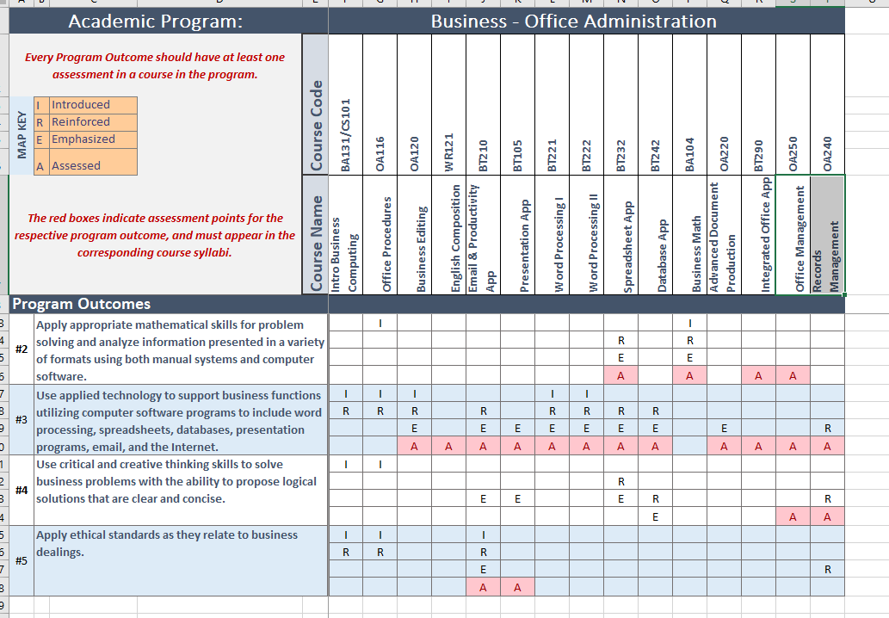
Program Level Outcomes

Slide 47
Program Level Outcomes next steps:
Steps:
Map courses to the Program Outcomes -- Done
Instructor review the Program Outcomes to ensure they believe they are accurate & relevant (assess the overall outcomes of the program).
Bring them to your Fall Advisory Committee and explain… a student that completes your class will be able to: ***
Get their feedback.
  Are they still relevant? (e.g., Add, Edit, Delete)
  Prioritize - What is the highest priority / most important?
  Does there exist sequence? 1 before 2, etc.
  (Document and determine next steps)
Then at the Spring meeting begin to look at the courses that you have connected to the Program Outcomes and ensure what is in the course, is working toward the desired Program outcome.

Slide 48
Program Level Outcomes
Questions – About Program Outcome Assessment ?

Slide 49
Guided Pathways
Overview:
Guided Pathways is a systematic change to the way we assist students.
The goal is:
Help our students determine a “path.”
Help ensure the student stays on the “path.”
Help ensure the student completes the “path.”

Slide 50
Guided Pathways
Team:
President Dana Young
VP Eddie Alves
VP Brad Hammond
Dean David Koehler
Sandy Porter
Carol Buttice
Stephanie Oester
Sharlene McCaslin
Gina Roper
Yumiyo Okuda
Dora Galan
My ask is for Additional Faculty involvement.

Slide 51
Guided Pathways
We want to create paths for students who wish to be:
Teacher (Math, English, History, etc.)
Psychologist
Chemist
Biologist
Etc.
And .. Clear Articulation Agreements with 4-year Colleges and Universities to ensure our students can transfer “seamlessly” to those schools.

Slide 52
Guided Pathways
Team:
Again…
My ask is for Additional Faculty involvement.
Questions ?

Slide 53
Strategic Plans and
Core Themes
I have reviewed every plan input into the Strategic Planning system for 2020-21.
I have been working this Summer on the “Master Plans.” Academic Master Plans, Student Service Plan, Administrative Service Plan and the Facilities Master Plan.
Our goal is to help demonstrate how your work ties directly to the Mission of the College which is:

Slide 54
Strategic Plans and
Core Themes
TVCC is a comprehensive Community College dedicated to Student Success !

Slide 55
Strategic Plans and
Core Themes
My review revealed a lack of knowledge about the Core Theme definitions:
There are three Core Themes:
Fostering Educational Success
Ensuring Access
Building our Community
But what is the definition….
(i.e. How do I know if my goal should tie to Fostering Educational Success or Ensuring Access?

Slide 56
Strategic Plans and
Core Themes
Example:
Goal: To administer (3) FASFA nights; one in Ontario, one in Nyssa and one in Vale.
Is this ?
Fostering Educational Success
Or
Ensuring Access ?

Slide 57
Strategic Plans and
Core Themes
Before you decide –
Example:
Goal: To administer (3) bilingual FASFA nights; one in Ontario, one in Nyssa and one in Vale.
Is this ?
Fostering Educational Success
Or
Ensuring Access ?

Slide 58
Strategic Plans and
Core Themes
Some are easy:
Enter Gen Ed Outcomes
Correct Numbering Sequence for Intermediate Concert Choir Component.
Clearly for All Students

Slide 59
Strategic Plans and
Core Themes
Some are easy:
CAHEP Accreditation Initial Application
Utilization of CAPPEX and non-traditional recruiting to enroll students without a GED
For specific groups of students

Slide 60
Strategic Plans and
Core Themes
Some are difficult:
Increase Course Reserves
Update / Make accessible Laptop Computers and Cart

Slide 61
Strategic Plans and
Core Themes
We wanted to make sure we were all defining these two Core Themes the same.
In the review, The Building our Community Core Theme, seemed to be understood by all.

Slide 62
Strategic Plans and
Core Themes
We wanted to make sure we were all defining these two Core Themes the same.
In the review, The Building our Community Core Theme, seemed to be understood by all.

Slide 63
Strategic Plans and
Core Themes
Any Last Questions ?
Have a Great Year !

