Slide 1

Student Success Summit:
Faculty TRAINING
Quantitative Reasoning
May 12th, 2020
Notes:
NOTE: Want a different image on this slide? Select the picture and delete it. Now click the Pictures icon in the placeholder to insert your own image.

Slide 2
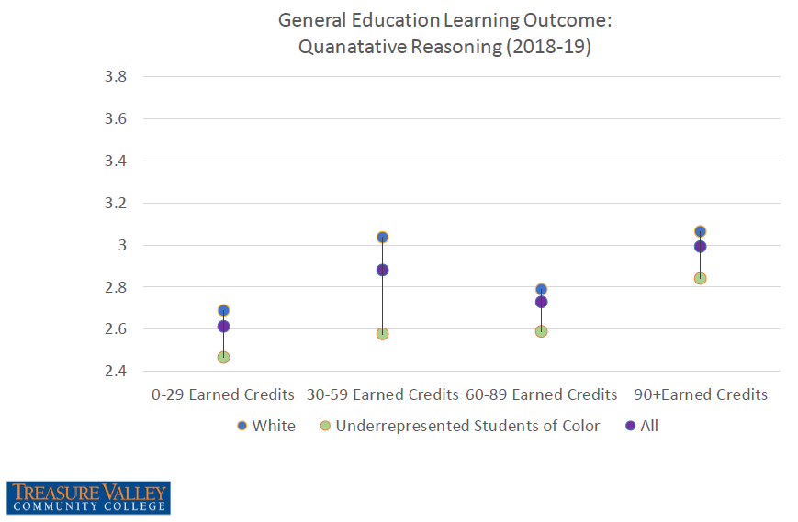
Remember Fall In-Service? (Sept 2019)

Slide 3
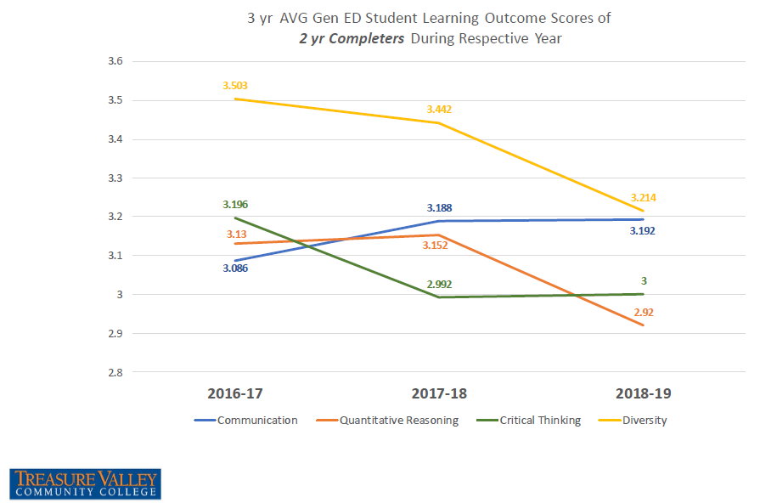
Remember Fall In-Service? (Sept 2019)

Slide 4

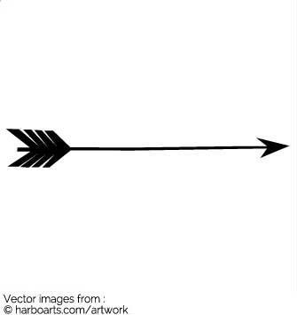
3.2

Slide 5
Total Number of Assessments of Gen ED Student Learning Outcomes 2019-20 Goal
1400

Slide 6
Total Number of Assessments of Gen ED Student Learning Outcomes 2019-20 Goal
Term | Fall | Winter | Spring
# of QR Assessments | 700 | 350 | 350
1400

Slide 7
Develop At Least Two Annual
Departmental Goals, That Focus on:
1. Supporting one of the Institutional Indicators:
  Enrollment
  Retention + Transfer-out Rates
  Completion Rates (IPEDS Cohort)
  Student Loan Default Rate
  AND
2. Gen Ed Learning Outcome - Quantitative Reasoning Targets
2 Year Completer GE Learning Outcome scores
Total Number of GE Learning Outcome Assessments
3.2
1400
Notes:
Enrollment
FTE
RFTE
Headcount
Fist-time, Full-time, Entering in Fall, degree/certificate seekers (IPEDS Cohort)
Annual unduplicated Full-time (by term), degree/certificate-seekers
Annual unduplicated Part-time (by term), degree/certificate-seekers
Annual non-credit, non-degree/cert-seekers (by term)
Retention + Transfer-out Rates
Fall-to-Winter Retention of IPEDS Cohort / Transfer-out Rates
Fall-to-Fall Retention of IPEDS Cohort / Transfer-out Rates
Completion Rates IPEDS Cohort
150%GR
200%GR
Student Loan Default Rate

Slide 8
General Education Learning Outcome Assessment Quantitative Reasoning
FACULTY TRAINING – Examples of QR Instructional Assessments
Sandy Porter (Agriculture)
Darin Bell (Business)
Jessica Briedinger (Social Science)
Notes:
Enrollment
FTE
RFTE
Headcount
Fist-time, Full-time, Entering in Fall, degree/certificate seekers (IPEDS Cohort)
Annual unduplicated Full-time (by term), degree/certificate-seekers
Annual unduplicated Part-time (by term), degree/certificate-seekers
Annual non-credit, non-degree/cert-seekers (by term)
Retention + Transfer-out Rates
Fall-to-Winter Retention of IPEDS Cohort / Transfer-out Rates
Fall-to-Fall Retention of IPEDS Cohort / Transfer-out Rates
Completion Rates IPEDS Cohort
150%GR
200%GR
Student Loan Default Rate

Slide 9
Institutional Effectiveness Meeting – Feb 18th, 2020
Participants:
  Tessa McFetridge
  Jacob Loomis
  Dr. Nathan Rawlinson
  Suzanne Bolyard
  David Koehler
  Eddie Alves
  Yumiyo Okuda
  Miguel Lopez

Slide 10

Institutional Effectiveness Meeting – Feb 18th, 2020
Recommendations
Continue to improve the number of data points
Conduct Inter-rater Reliability Training
Conduct Faculty Training on How to Improve overall QR skills of students

Slide 11

Feb 24, 2020 – Email from VP Alves
As requested at In-Service, the focus for the year is to increase our Institutional Learning Outcomes is in the area of
Quantitative Reasoning
Please continue to input your General Education Outcomes (Institutional Learning Outcomes) this quarter.
We are at:
627 data points
On our goal of 700 for the Fall – 1400 for the year.
Again, I just wanted to reach out and thank the faculty that continue to move this forward and report some results.
Thank you.

Slide 12
As of Today
We are at:
data points
On our goal of 700 for the Fall – 1400 for the year.
837

Slide 13
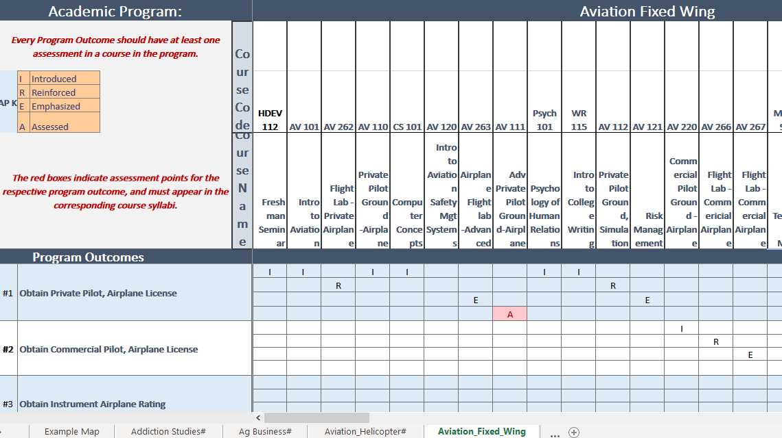
We Want Your Assessment Examples
Faculty -
Please send Eddie or Dave any innovations, changes, or examples you have made throughout the year, or think are good training tools, with respect to QR assignments, assessments.
We want to host a Canvas Shell with examples and other training tools, as a resource for our faculty and adjuncts.
A step towards “closing the loop” for improving teaching and learning with respect to QR skills.

Slide 14
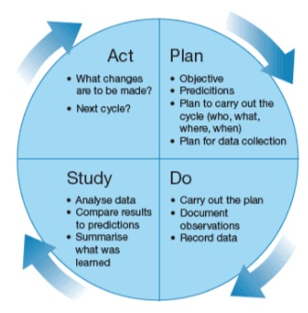
Next Steps
Fall In Service:
Review Data. PDSA: Did We Move the Needle? What Changes Can we Make?
Do We Adjust Our Focus?

Slide 15
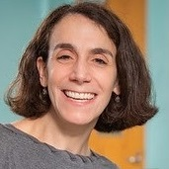
Keynote Speaker: Dr. Esther Isabelle Wilder
Quantitative Reasoning Across the Curriculum:
Best Practices for Effective Teaching

Slide 16
Keynote Speaker: Dr. Esther Isabelle Wilder
Dr. Esther Isabelle Wilder, Professor of Sociology at Lehman College, CUNY, is founder of the Quantitative Reasoning (QR) faculty development program at Lehman College. She also serves as principal investigator and director of an NSF-funded faculty development program to increase students’ QR skills by the implementation of a data analysis research experience (DARE). Her earlier projects, also supported by NSF, have provided training to hundreds of faculty representing a wide range of disciplines across the social sciences, life and physical sciences, and humanities.
Dr. Wilder’s current research focuses on multidisciplinary QR initiatives and on the sociology of disability, inequality, and health behaviors and outcomes. She is the author of Wheeling and Dealing: Living with Spinal Cord Injury (Vanderbilt University Press, 2006) and coauthor of Voices from the Heartland: The Needs and Rights of Individuals with Disabilities (Brookline Books, 2005). Her scholarly work has appeared in more than a dozen journals including Numeracy, Scientometrics, Studies in Contemporary Jewry, The Milbank Quarterly, Social Science Research, Sociological Perspectives, Teaching Sociology, The Gerontologist, and the Journal for the Scientific Study of Religion.

Slide 17
Webinar
Please do NOT use the CHAT. You are unable to send private chats (Panelists and Host will see all chats)
If you have a question for Dr. Wilder, you may:
  Type your Question into the Q&A, and Dr. Wilder will see this pop up in real time, and she will respond as she is able; or
  If you prefer to speak, “Raise Your Hand” virtually, and we will open up your mic for you to converse with Dr. Wilder directly.
This Webinar will be recorded, so you can refer to it later.

Slide 18
Thank You
Questions?

