Slide 1
Student Success Summit
May 11, 2021

Slide 2
Agenda
Welcome and Announcements
General Education / Institutional Learning Outcomes
Inclusive Teaching Strategies Project
TLA Taskforce
Summer Institute
In-Service Educational Training Options
Accreditation Update

Slide 3
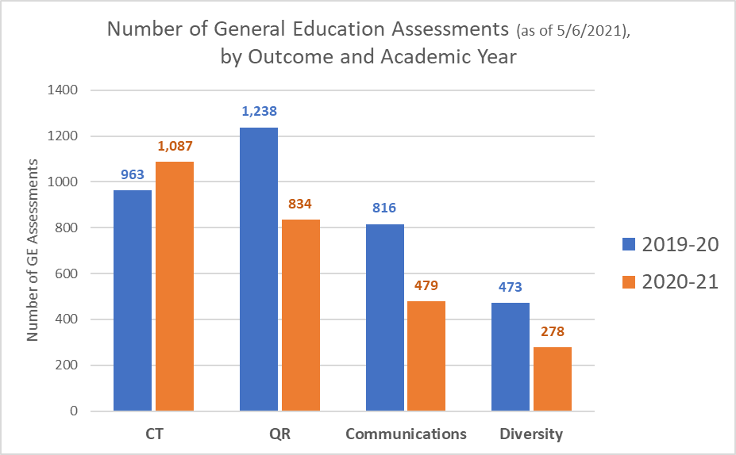
General Education Assessments - Update

Slide 4
General Education Assessments - Update
Target 1,400

Slide 5
General Education Assessments - Update
  Questions?

Slide 6
Inclusive Teaching Strategies (ITS)
Pedagogical research has consistently shown that application of teaching approaches focused on inclusive elements are essential for student success.
When our commitment truly is student academic success to include enhanced Institutional Learning Outcomes, then classroom atmospheres pedaling on hierarchical pedagogical structures are no longer needed because they don’t serve our students.
The culturally diverse world we live in implies an adjustment of our collective teaching strategies to empower all students. It’s not a matter of choice. It’s an inevitability for student success. Affirmation of equity in and out of the classroom benefits—rather than hinders—student academic and professional life success.
Therefore, it is imperative that instructors start seamlessly embedding inclusive elements into their daily assessment of students’ Critical Thinking, Quantitative Reasoning, Values and Attitudes and Communication. (Otilia Gaidos)

Slide 7
Inclusive Teaching Strategies (ITS)
Based on the results of our MF assessment from 2019-20
ITS Pilot Project began during Fall term 2020-21
Faculty and adjunct participants were paid a stipend to
  1) attend training on inclusive teaching strategies during Fall term;
  2) implement at least one of the inclusive teaching strategies into their course(s) during Winter term; and
  3) report out to faculty how the implementation fared.

Slide 8
Inclusive Teaching Strategies (ITS)
In the Fall, the following faculty and adjuncts participated in
the 5-week Inclusive Teaching Strategies training:
  Wayne Fischer
  Michael Fisher
  Jayne Forwood
  Katya Gourley
  Joe Kurth
  Otilia Gaidos
  Renae Weber
  Phil Mahaffey
  Darin Bell
  Tanya Crawford

Slide 9
Inclusive Teaching Strategies (ITS)
An ancillary part of this project, Otilia Gaidos individually coached the following adjuncts on Inclusive Teaching Strategies AND Institutional Learning Outcomes assessment:
                Lance Morris
                Lauri Babcock
                Charles Johnson
                James Taylor

Slide 10
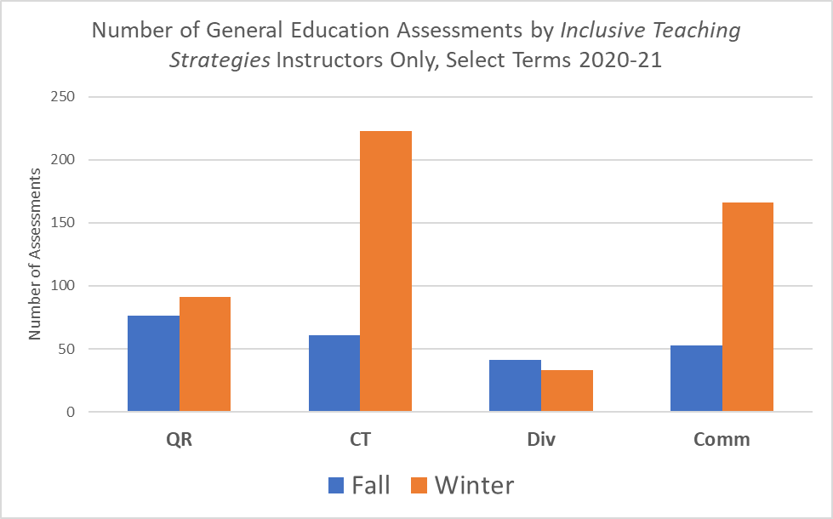
Inclusive Teaching Strategies – Quantitative Data

Slide 11
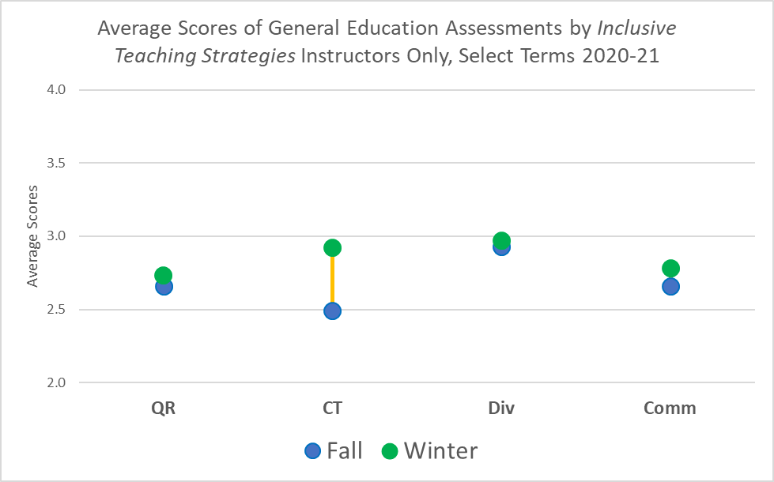
Inclusive Teaching Strategies – Quantitative Data
https://reports.tvcc.cc/ReportServer?%2fPublic&rs:Command=ListChildren
Select respective “Gen Ed Outcomes v2” report with “ITS” at the end

Slide 12
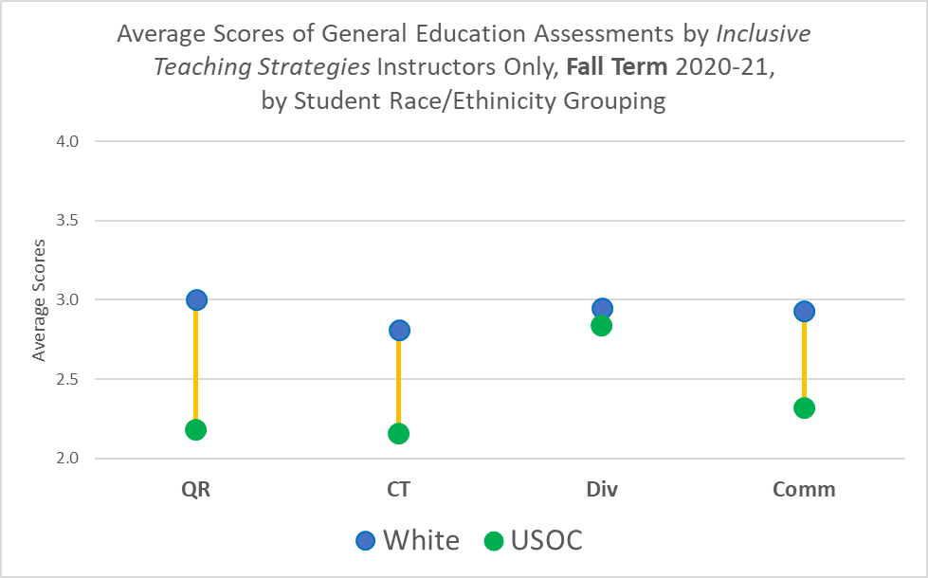
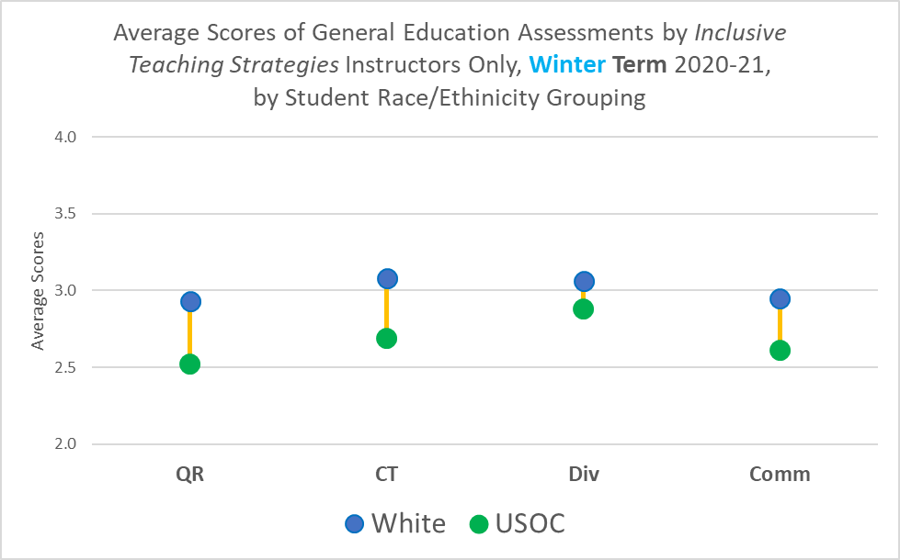
Inclusive Teaching Strategies – Quantitative Data – Equity Lens 1

Slide 13
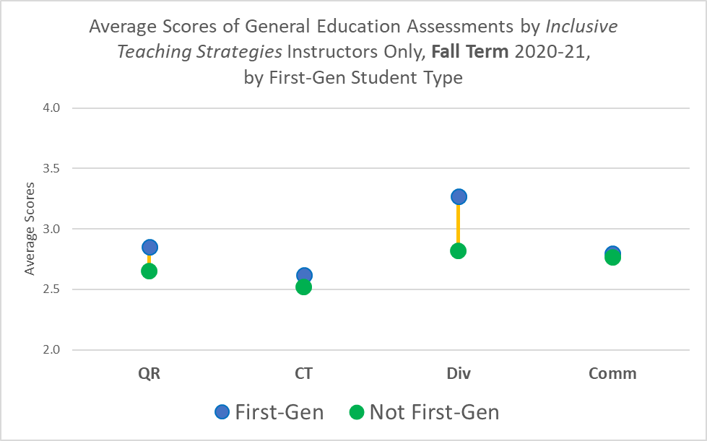
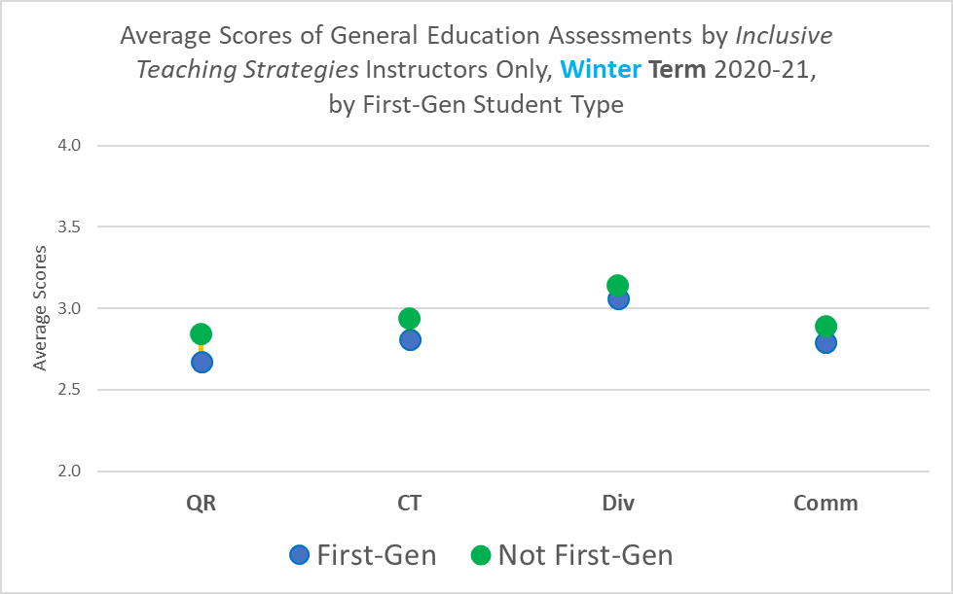
Inclusive Teaching Strategies – Quantitative Data – Equity Lens 2

Slide 14
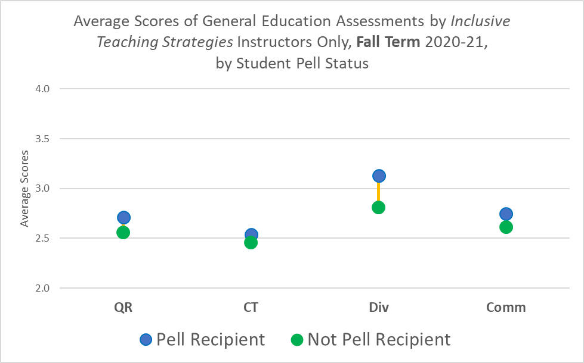
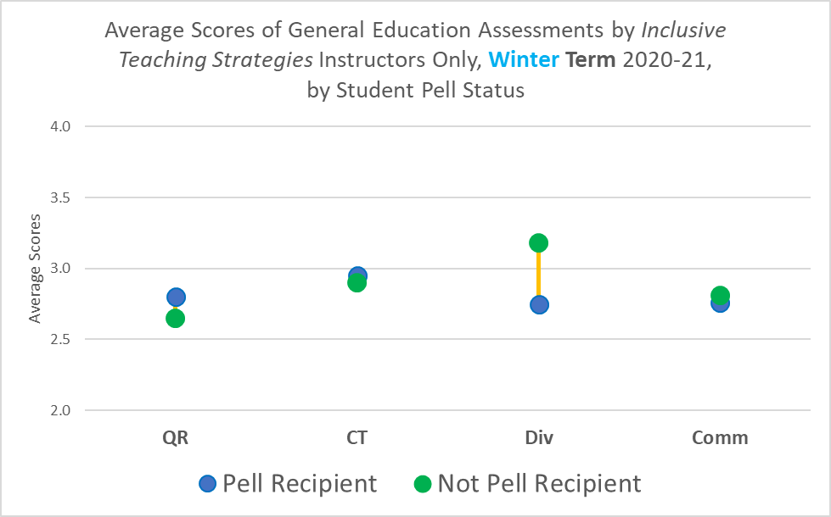
Inclusive Teaching Strategies – Quantitative Data – Equity Lens 3

Slide 15
ITS - Qualitative Data
  Wayne Fischer
  Otilia
  Tell us what you learned from the Inclusive Teaching Strategies training. (Training Highlights)
  What strategies did you implement during Winter term? (Strategies Employed)
  What observations during implementation? (Observations)

Slide 16
ITS – Training Highlights (Wayne Fischer)
  An easy first step towards inclusive teaching strategies is to review and edit one’s syllabus so that it is accessible by all.
  Rethink exams: Important to think about creating equitable and inclusive assessments by providing different types of assessments.
  Important to engage students through active learning strategies and navigating differences.
  Develop culturally relevant & responsive teaching practices: respect student culture and understand the reality of current students and validate them so that they take ownership of their own learning.
  Implicit bias and microaggressions constantly influence our teaching practices and impact student learning.

Slide 17
ITS – Strategies (Wayne Fischer)
  Updated Syllabus with heading styles and readable font.
  Added in weekly short presentation assignment where students presented a new concept learned that week to the class later in the week after learning more about it themselves and sharing the details of what they had learned.
  When possible, engaged the students with the interactive physics demonstrations via physicsclassroom.com and students could each manipulate and use the interactive tools on their own electronic devices.
  Incorporated the use of Nearpod to create more interactive lectures and discussions and Edpuzzle to provide video content with assessment questions that could be answered at the students’ own pace.
  Created an end of the term research project where students could pick a topic relevant to the subject matter of the term, complete a literature review of the topic, and present what they learned. Students could decide to work in groups or individually. There was still a final exam, but there was equal credit for completing and submitting a term project.

Slide 18
ITS – Observations (Wayne Fischer)
  Updating the Accessibility of the Syllabus:
  No observable reactions, but for me the syllabus is much easier to read and understand.
  Use of NearPod and Edpuzzle
  Students are highly engaged with NearPod lecture since they are interacting on an equal level with it and no pressure assessment occurs, and student paced lectures can be created.
  Edpuzzle allows short videos to be incorporated into the weekly homework and be assessed and taken at the students own pace.
  Weekly short presentations of a physics concept (interactive project and different assessment):
  Students were excited and enjoyed the opportunity to present a new concept from the subject matter that week and present it to the group later in the week.
  One student said the assignment forced him to really read the material so that he could present it to the rest of the class.
  As the material became too complicated it became obvious that students needed to have more background and time to learn the material in order to present it properly.
  Students asked to have the weekend available to prepare a short presentation rather than just two days.
  Students worked on presentation and communication skills and general feeling of engagement was obvious.
  End of term research project (different type of assessment):
  Students enjoyed working in stages on a long-term project and they felt empowered by choosing their own topic relevant to the course content.

Slide 19
ITS – Wayne Fischer
  Questions for Wayne?

Slide 20
ITS – Training Highlights (Otilia Gaidos)
The training reinforced my teaching and learning philosophy that has been naturally centered on an essential valuation for diverse thought, creative collaboration and an atmosphere of intellectual impartiality.
The training served as reaffirmation to me that inclusivity in the classroom enhances student academic performance: an instructor-student rapport focused on equity via gentle guidance, impartiality, empathy, patience and mutual respect raises Institutional Learning Outcomes.
I’ve learned that culturally relevant pedagogy is important because it inspires resilience, it is multi-dimensional, it encourages diverse perspectives, it values experience, it supports critical thinking, and it improves outcomes.

Slide 21
ITS – Strategies (Otilia Gaidos)
In my Ethnic Studies 102 course, I incorporated each of the four Institutional Learning Outcomes and coupled each with Inclusivity. I will mention 2 Projects.
Project 1
  This project assessed Attitudes and Values and Critical Thinking coupled with Inclusivity.
  I had students watch a 30 minute educational video of a respectable minority scholar in the ethnic studies field. I asked students to take good notes and form two groups.
  Group A was asked to support one of minority scholar’s ideas while using at least five concepts learned in class.
  Group B was asked to refute one of minority scholar’s ideas while using at least five concepts learned in class.
  This exercise asked students to argue for ideas they may not necessarily support; and refute ideas they may actually support. The goal was to cultivate respect for difference and other people’s perspective while cementing an understanding of how attitudes and values shape people’s lives; and improving students’ critical thinking. (Otilia Gaidos)

Slide 22
ITS – Strategies (Otilia Gaidos)
Project 2
  This project assessed Inclusivity-embedded Quantitative Reasoning, Critical Thinking and Communication.
  I asked students to use the thinking lens of a social justice activist they have already researched as part of their compare/contrast paper and give an informal presentation offering feedback on the graph of their classmate’s compare/contrast paper.
  While intellectually sophisticated, this project invited a relaxed method of student participation – the informal aspect of the presentation made students feel comfortable, it took the pressure of being correct/incorrect out of their thinking lens. When in their comfort level, students stretched their intellectual abilities to greater heights. (Otilia Gaidos)

Slide 23
ITS – Observations (Otilia Gaidos)
Students were taken by surprise and welcomed these out of the box, inclusivity focused activities.
The activities made students feel more involved and respected. It also gave students a gentle push to do more, to ask and expect more of themselves, to offer more intellectual strength in their learning process.
They were asked by me to go beyond what they’ve accustomed to. That was refreshing to most and it provided a tool on my part to partially erase the apathy many of them display vis-à-vis current socio-political events in the world.
Some students did not come to class every day and they missed out on these enriching educational additions. That saddened me.
So, my task next term is to work harder in convincing some of these students to come to class regularly so that they can participate in alternative active learning assignments that assess Inclusivity-embedded Institutional Learning Outcomes. One way for me to execute above task is by coming up with activities that empower students even more and in that process enhance their intellectual curiosity. (Otilia Gaidos)

Slide 24
ITS – Otilia Gaidos
  Questions for Otilia?

Slide 25
ITS – Feedback from Other Instructors
Jayne Forwood implemented Inclusive Teaching Strategies in her HDEV 112 course in the Winter
Jayne Forwood assessed Inclusivity-embedded Communication skills. Jayne added a journal assignment. The aim of the journal was to allow students who were shy and/or with different learning styles to speak their minds and ask questions via journaling. This assignment enhanced students’ written communication skills. The focus was particularly on those students who don’t always have a voice because they might feel uncomfortable in big crowds or formal classroom settings.
Jayne states:
“I think the journal and questions have been productive for the students. Those who are afraid to ask questions in class have a way of asking in a private way. I am hoping that the outcome by the end of winter quarter is that the students are familiar with TVCC and college in general. I hope that they will be stronger students and encouraged to ask questions … Yes, I think this will help in the long run. It has been a good learning experience for me.”

Slide 26
ITS – Feedback from Other Instructors
Michael Fisher added Inclusivity in the Critical Thinking and Quantitative Reasoning rubrics in his Winter course CHEM 104.
Michael added Exit Tickets for the critical thinking component. Michael also added a student presentation on women and/or people of color in Chemistry, which covered the Quantitative Reasoning component.
Michael states:
“[the Exit Ticket assignment] helped class transition from one answer given by a strong student to an answer given by all students…”

Slide 27
ITS – Feedback from Other Instructors
Dr. Renae Weber about Inclusive Teaching Strategies:
“I learned about making more space in the syllabus to allow for electronic readers to be able to access the material more easily. This term I made sure that my syllabus were easier to access, by adding space and trying some of the ideas presented in class.”

Slide 28
Inclusive Teaching Strategies - Next Steps
Open Discussion from Faculty – suggestions for Fall ??

Slide 29
Inclusive Teaching Strategies - Next Steps
FREE Resource for TVCC Faculty & Adjuncts
Association of College and University Educators (ACUE)
Inclusive Teaching Practices Toolkit
Teaching, Learning, and Assessment Task Force
Summer Training on Assessment

Slide 30
Teaching, Learning, & Assessment Task Force
Objective – Targeted Faculty Professional Development to Advance a Culture of Assessment
Beginning AY 2021-22
Pay Structure
  1 Faculty Lead - 3 Credit Load each term (Fall, Winter, Spring)
    approx. 3 hours/week
  3 Faculty Analysts – 1 Credit Load each term (Fall, Winter, Spring)
    approx. 1 hour/week
  1 Adjunct Analyst – 1 Credit Load each term (Fall, Winter, Spring)
    approx. 1 hour/week

Slide 31
Teaching, Learning, & Assessment Task Force
Expectations
  Faculty Lead
    Meets bi-weekly to Collaborate with Director of IE & P
    Develops Analysis & Communication of
      Emphasis & Program Assessments
      Institutional Outcomes
      Mission Fulfillment
    Communication of Above Analysis
      Report to Administrative Team Monthly
      Report to IE Committee
      Report to Academic Leadership Team

Slide 32
Teaching, Learning, & Assessment Task Force
Expectations
  Faculty & Adjunct Analysts
    Meets monthly to Collaborate with Faculty Lead and Director of IE & P
    Assist with the Analysis & Communication of
      Emphasis & Program Assessments
      Institutional Outcomes
      Mission Fulfillment

Slide 33
Teaching, Learning, & Assessment Task Force
  Questions?

Slide 34
In-Service Educational Training Options
I would like to use some time during In-Service to expanding training to all.
After the Summer Institute we will have a discussion about what might be needed for all Faculty that we can share at In-Service

Slide 35
In-Service Educational Training Options
  Questions?

Slide 36
Accreditation Update
Northwest Commission on Colleges and Universities (NWCCU) Mid-Cycle Self-Evaluation Report and Visit of Fall 2021
Visit Details
  October 21-22,2021
  Virtual visit
  Two-person committee
Mid-Cycle Self-Evaluation Report
  Due September 1

Slide 37
Accreditation Update
Mid-Cycle Self-Evaluation Report
Structure of report / requirements:
  Mission Fulfillment
  Student Achievement
  Programmatic Assessment
  Moving Forward
  Addendums for Recommendations

Slide 38
Accreditation Update
NWCCU Recommendations:
Recommendation 1: Fall 2018 Mission Fulfillment and Sustainability - Remains as Non- Compliant and timeline extended for good cause to come into compliance in Fall 2021
  Revised Recommendation 1: Fall 2018 Mission Fulfillment and Sustainability -Engage in an effective system of assessment and use the results of its assessment efforts to inform academic and learning-support planning and practices to continuously improve student learning outcomes (2020 Standard 1.C.5 and 1.C.7).
Recommendation 2: Fall 2018 Mission Fulfillment and Sustainability - Continued as Needs Improvement
  Revised Recommendation 2: Fall 2018 Mission Fulfillment and Sustainability - Demonstrate a continuous process to assess institutional effectiveness; use an ongoing systematic evaluation and planning process to inform and refine its effectiveness, and, is inclusive and provides opportunities for comment by appropriate constituents (2020 Standard 1.B.1 and 1.B.3).
Recommendation 3: Fall 2018 Mission Fulfillment and Sustainability - Fulfilled

Slide 39
Accreditation Update
NWCCU Recommendations:
Recommendation 4: Fall 2018 Mission Fulfillment and Sustainability - Substantially in Compliance but in Need of Improvement
  Evaluate the sustainability of the College’s current staffing models and the organizational capacity to fulfill its mission due to employee turnover and shortages (ER 9, ER 24, and Standard 5.B.1).
Recommendation 5: Fall 2018 Mission Fulfillment and Sustainability - Substantially in Compliance but in Need of Improvement
  Improve transparency and dialogue, clarify the decision-making and operational roles of constituent groups, and encourage collegial, College-wide engagement of all constituencies (Standard 2.A.1, 2.A.5, 2.A.6, and 2.A.7).

Slide 40
Accreditation Update
Reminder: out of compliance on assessment
“Engage in an effective system of assessment and use the results of its assessment efforts to inform academic and learning-support planning and practices to continuously improve student learning outcomes (2020 Standard 1.C.5 and 1.C.7).”

Slide 41
Accreditation Update
  Meetings held with Department Chairs:
  Cindy Feibert on 5/4
  Jill Humble on 5/4
  Tanya Crawford on 4/29
  Suzanne Bolyard on 4/28
  Darin Bell/Nila Stephens on 4/19
  Meetings with Department Chairs to be scheduled:
  Renae Weber
  Dennis Gill
  Marcus Nichols – scheduled 5/25
  Julie Lynch & Brianna Paddon

Slide 42
Accreditation Update
  Meetings focused on:
  Providing opportunities for faculty input into accreditation report
  Gathering information and evidence related to assessment for mid-cycle self-evaluation report
Assessment book TVCC is going to be purchased for Department Chairs:
Walvoord , B. E. (2010). Assessment Clear and Simple: A Practical Guide for Institutions, Departments, and General Education (2nd ed.). San Francisco: Jossey-Bass.

Slide 43
Accreditation Update
  Questions?

