Slide 1
Supporting #RealCollege Students in the Pandemic
Sara Goldrick-Rab
Hope Center for College, Community, and Justice

Slide 2





Slide 3
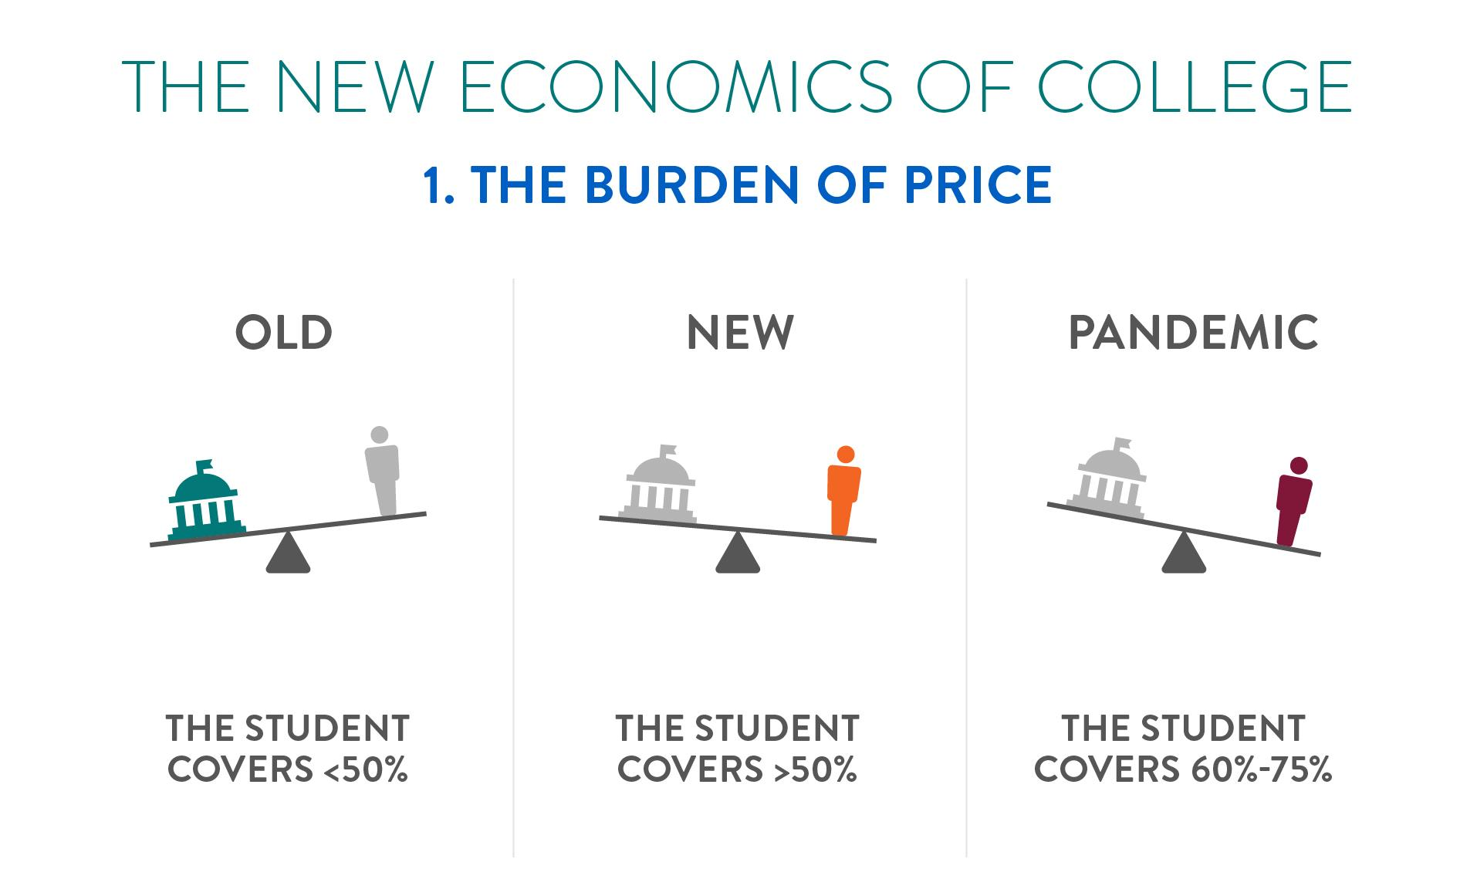

Slide 4
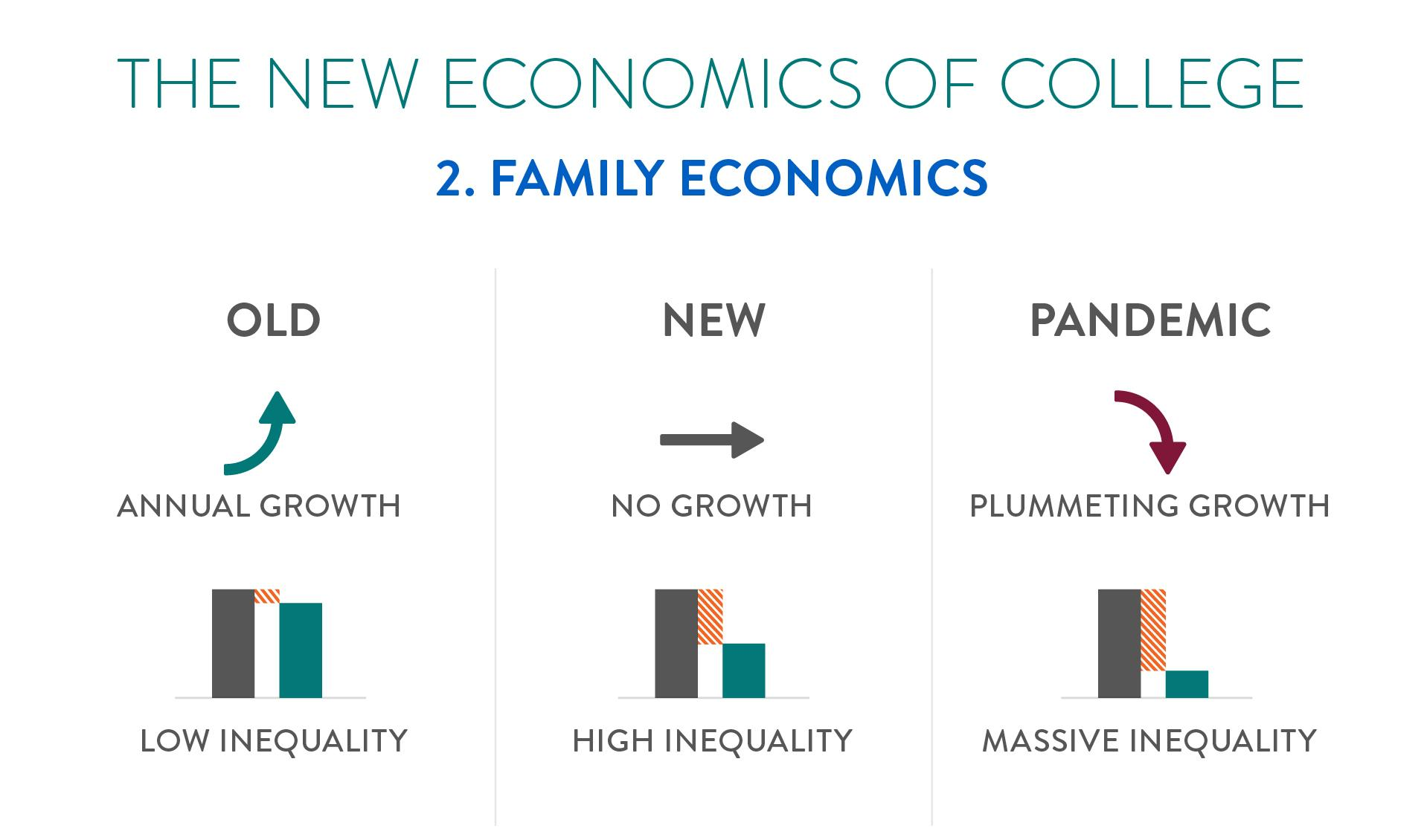

Slide 5
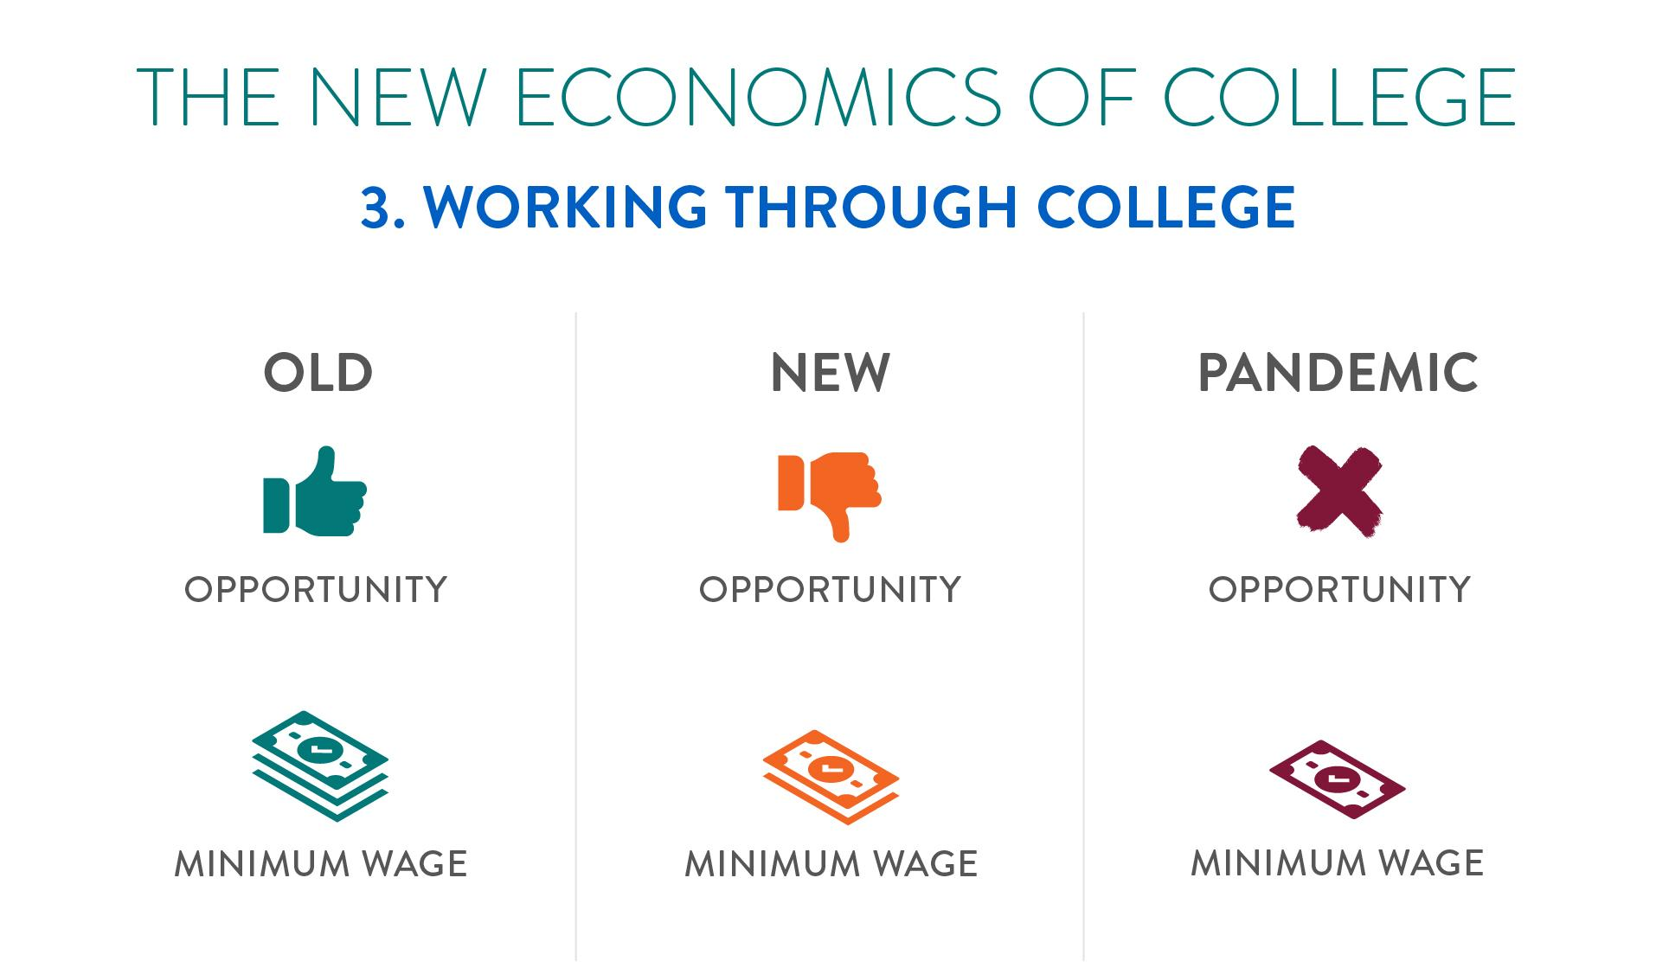

Slide 6
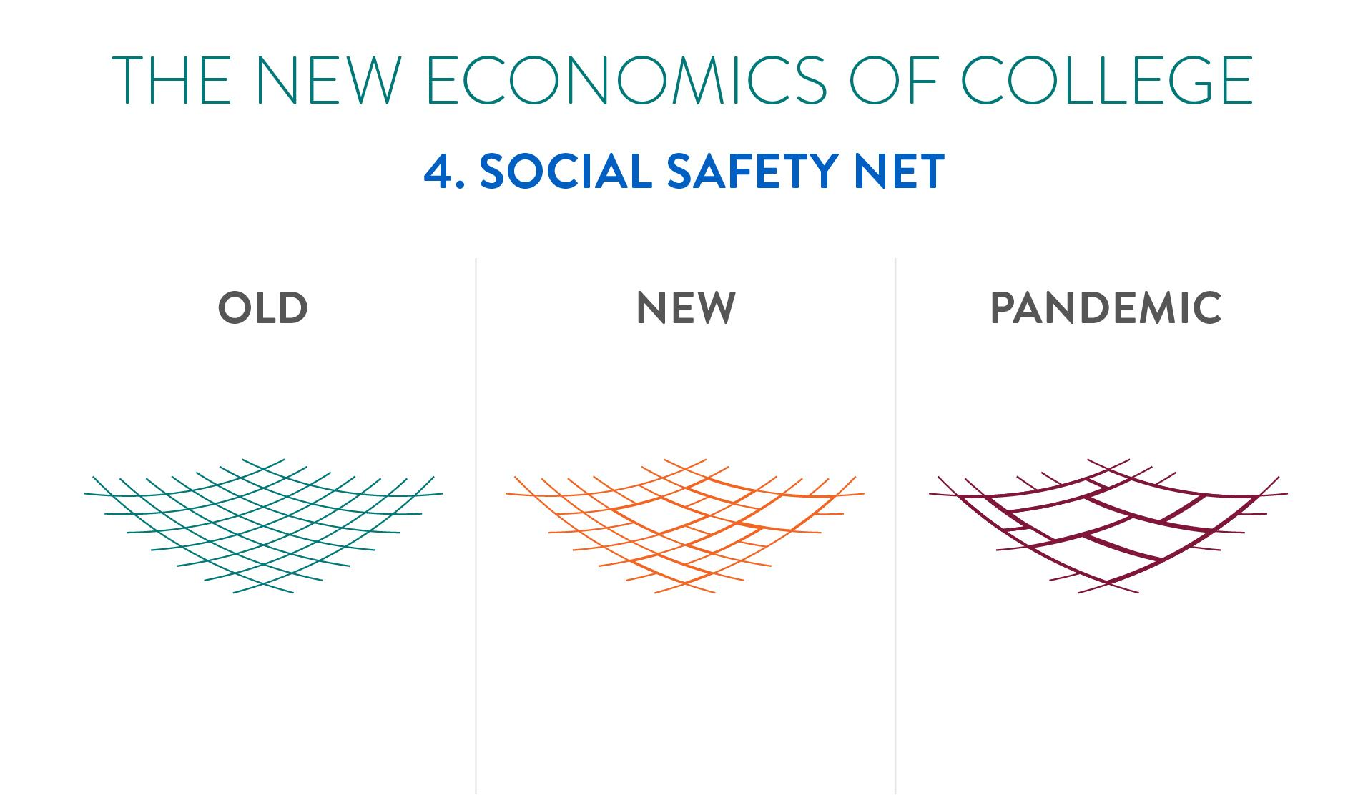

Slide 7
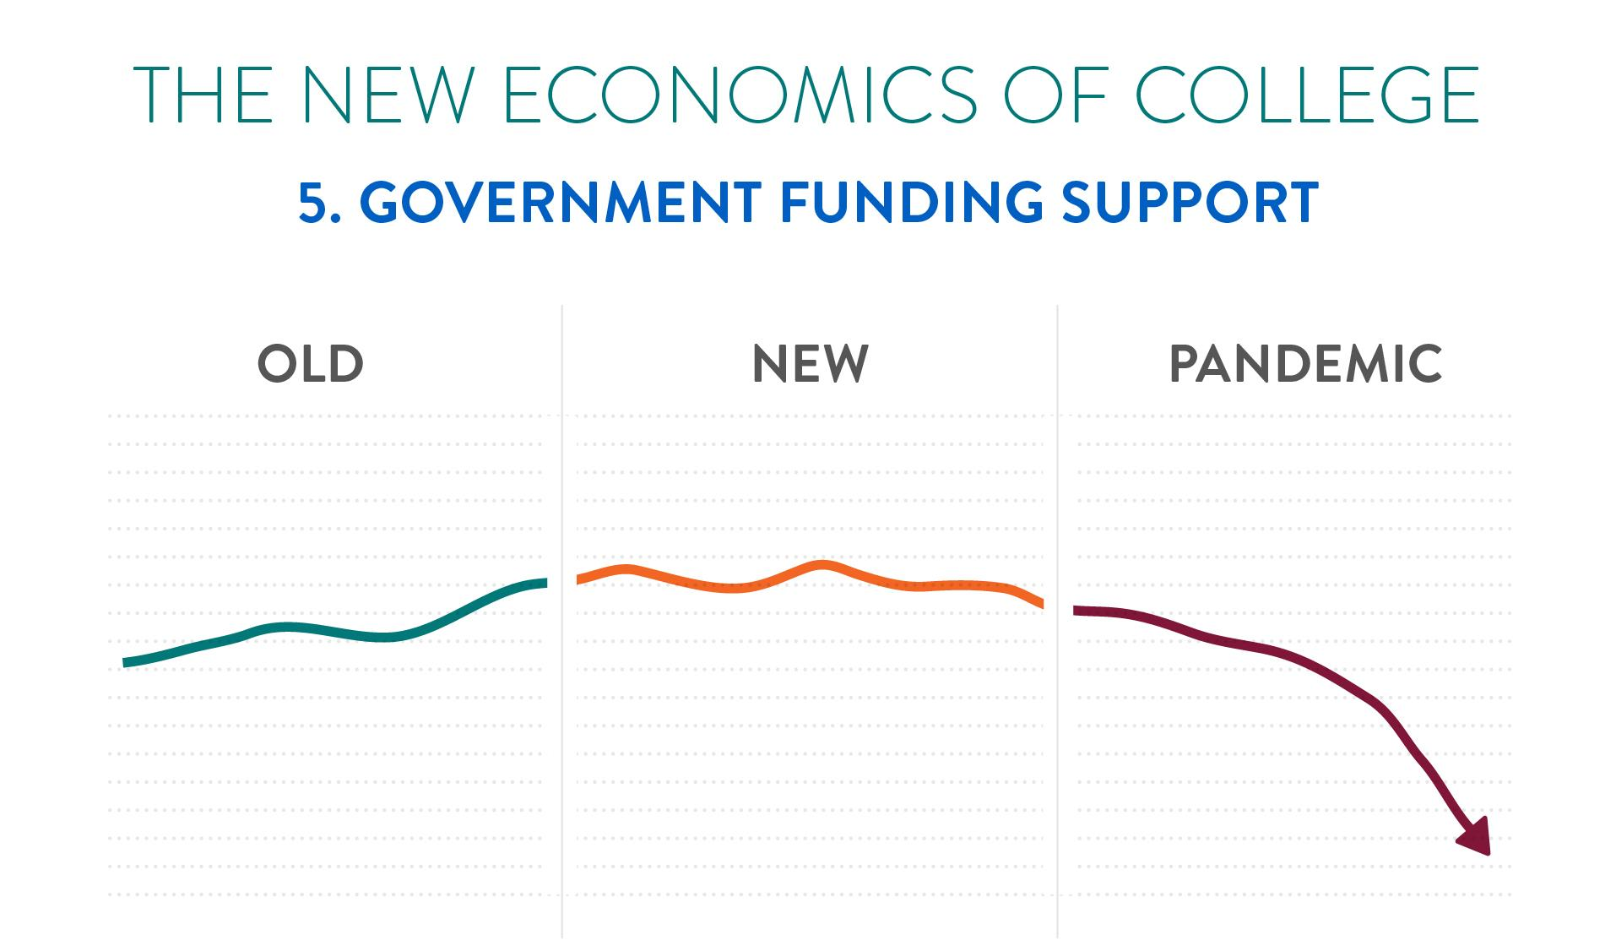

Slide 8
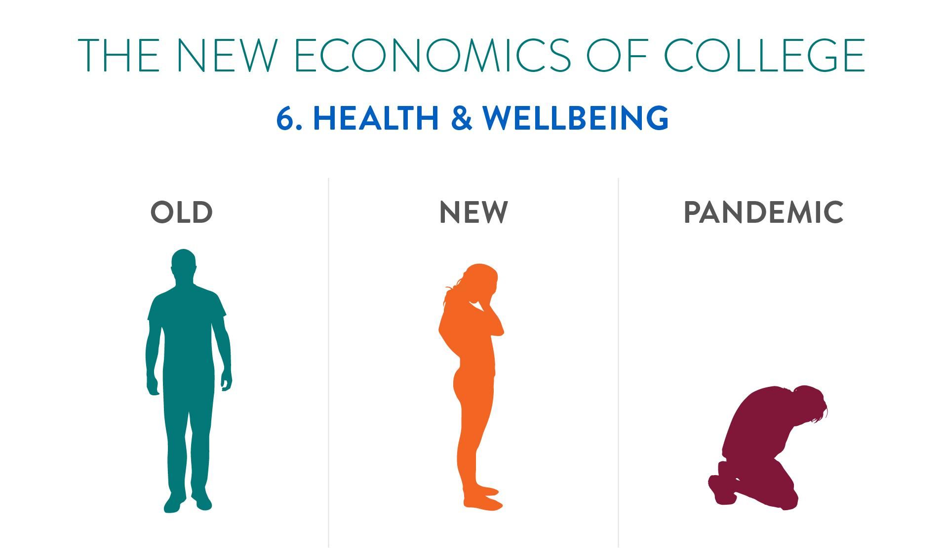

Slide 9
What happens outside the classroom matters for what happens in it…

Slide 10

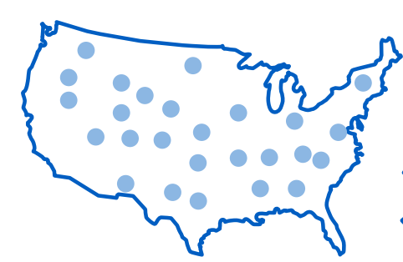

PANDEMIC DATA FROM AN
ELECTRONIC SURVEY COMPLETED IN APRIL/MAY 2020 BY
38,602
Students
26
States
39
Two-year Colleges
15
Four-year Universities
Notes:
Highlight that Treasure Valley and all Oregon CC’s participated

Slide 11
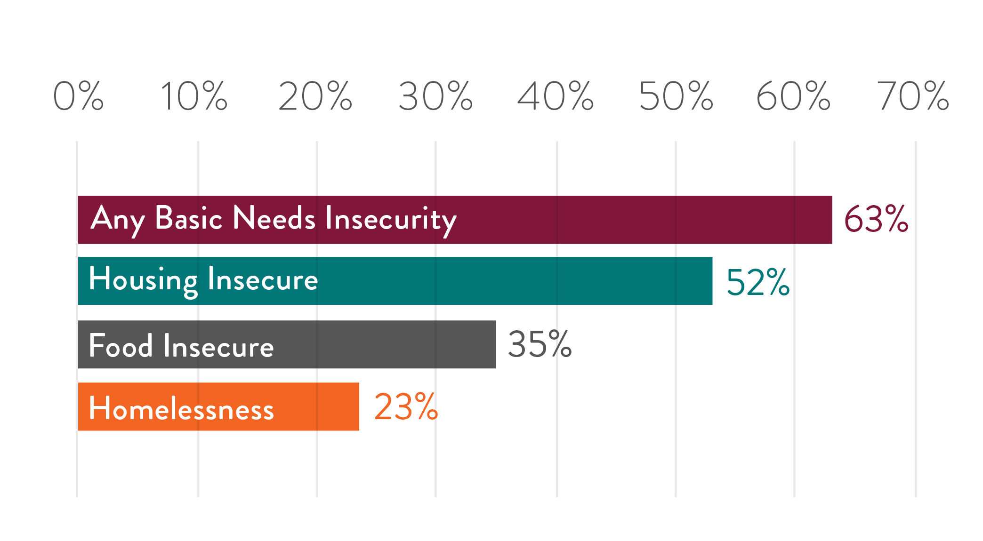
BASIC NEEDS INSECURITY RATES
TREASURE VALLEY

Slide 12
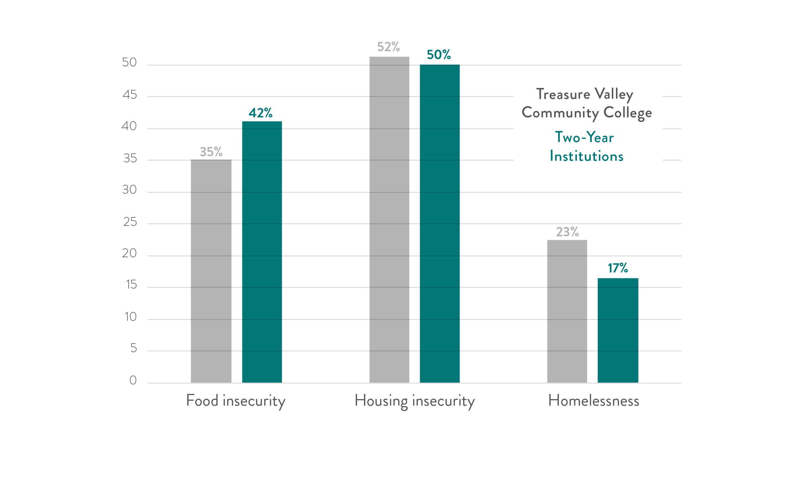
BASIC NEEDS INSECURITY RATES

Slide 13
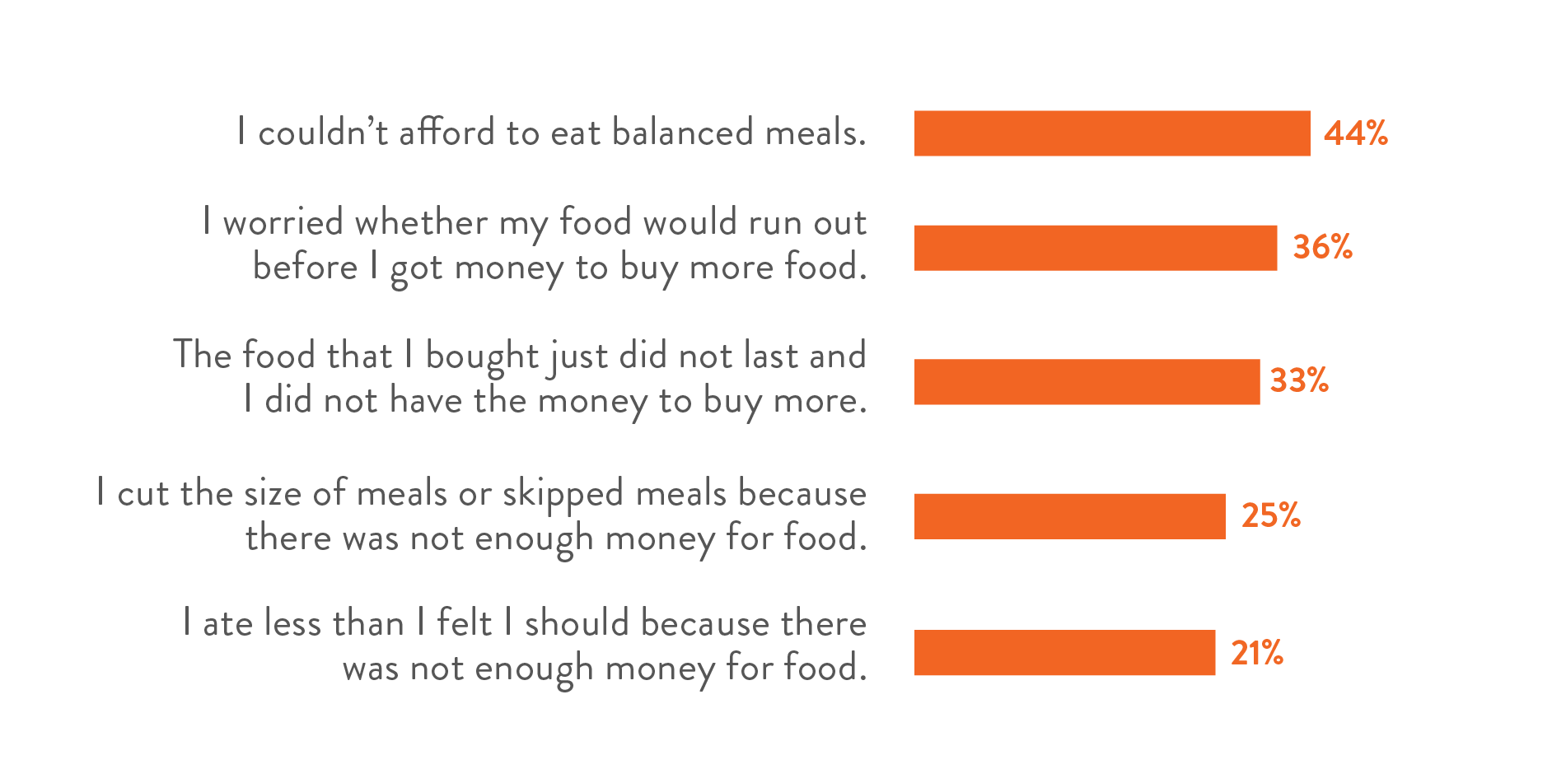
FOOD INSECURITY
TREASURE VALLEY

Slide 14
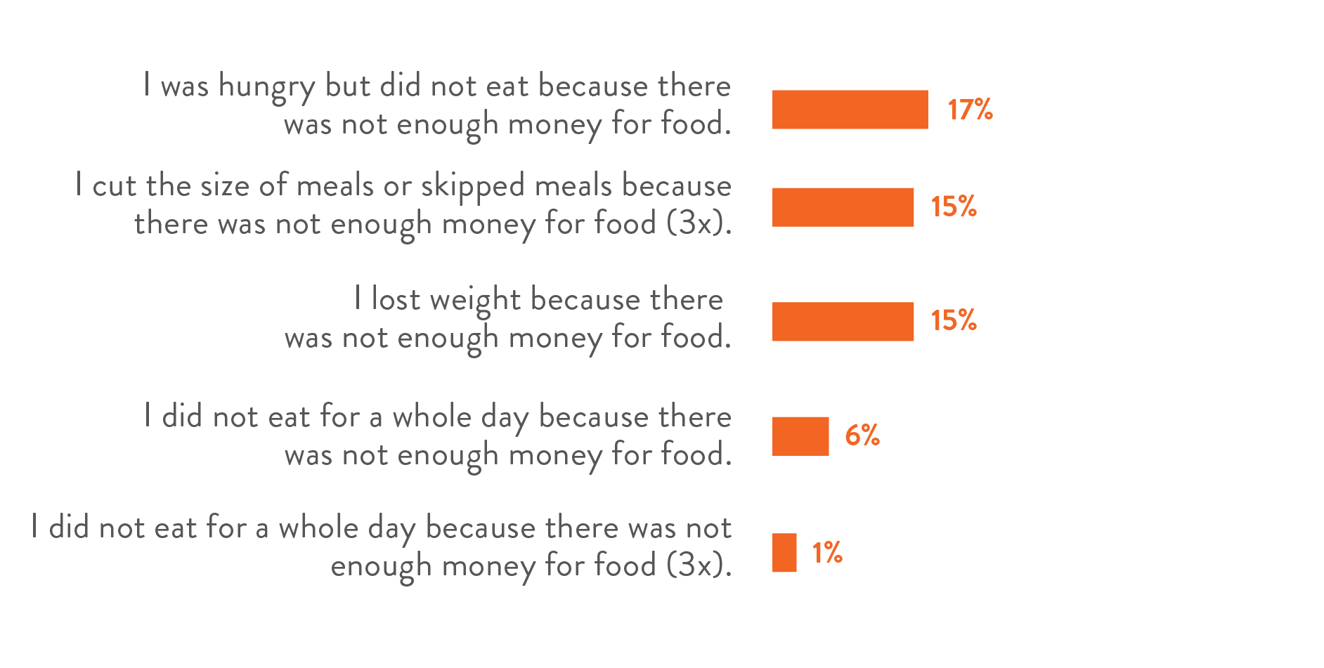
FOOD INSECURITY
TREASURE VALLEY

Slide 15

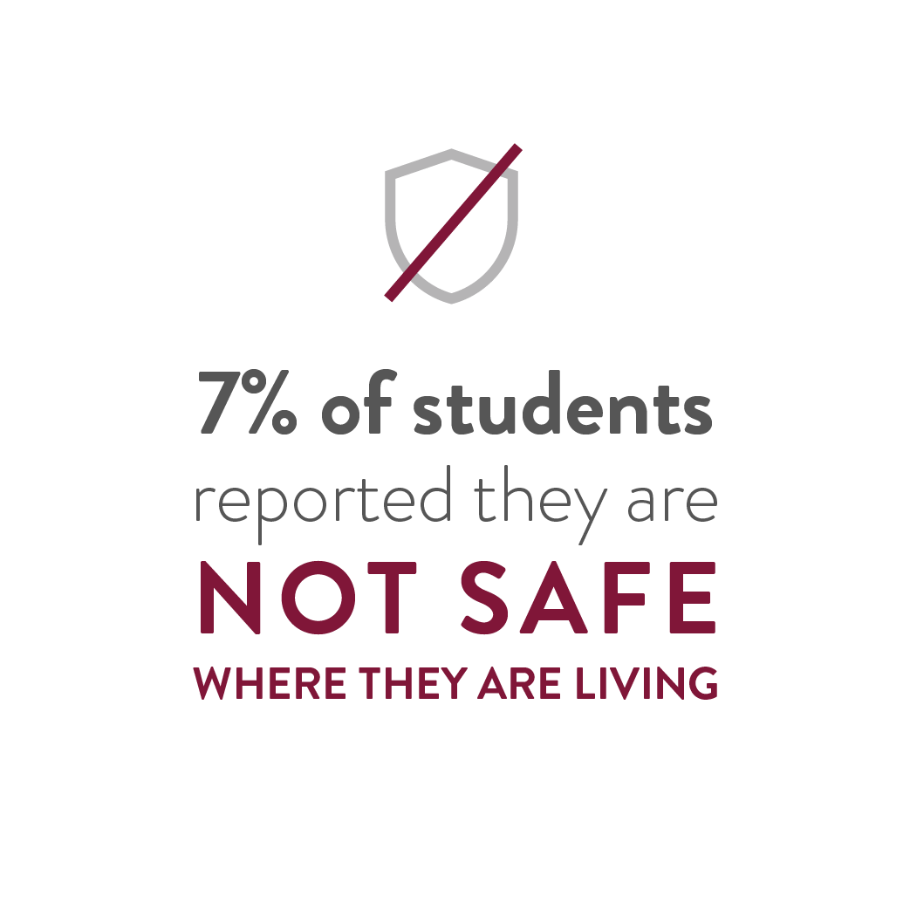

Slide 16
BASIC NEEDS INSECURITY RATES
8 PERCENTAGE POINT DISPARITY
67%
59%
White or Caucasian
Hispanic or
Latinx
Notes:
BNI for white students - 59.2%
BNI for Latinx students - 66.6%

Slide 17
BASIC NEEDS INSECURITY RATES
17 PERCENTAGE POINT DISPARITY
76%
59%
Student Does Not Have Children
Student Has Children
Notes:
BNI for parenting students - 76.4%
BNI for non-parenting students - 59.2%

Slide 18
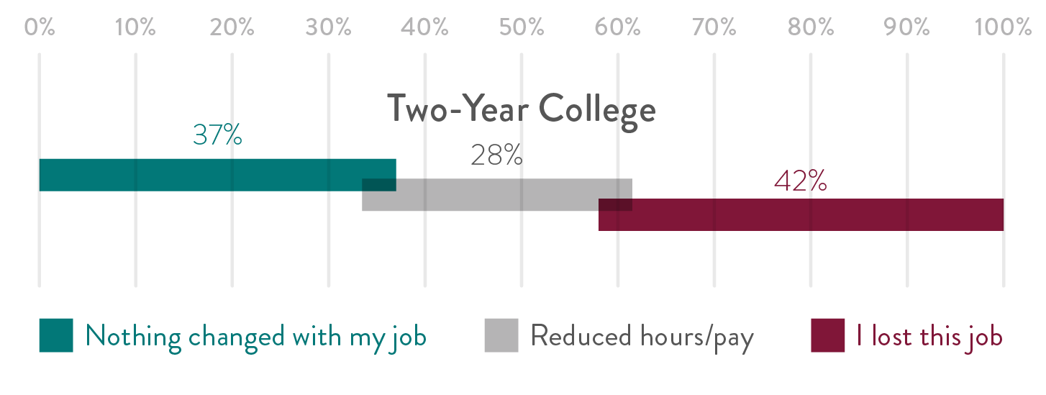
PANDEMIC IMPACTS ON
JOB INSECURITY AMONG
STUDENTS EMPLOYED
PRE-PANDEMIC

Slide 19

STUDENTS ARE EXPERIENCING ANXIETY
49%
AT TWO-YEAR COLLEGES

Slide 20

STUDENTS HAVE TO TAKE CARE OF FAMILY MEMBERS
41%
AT TWO-YEAR COLLEGES

Slide 21
MOST STUDENTS DID NOT GET THE HELP
THEY NEEDED
46%
Food insecure students using SNAP
22%
Basic needs insecure students using any campus support
Notes:
Replace this with info from this report showing (ASK VANESSA FOR EXACT NUMBERS)
% of food insecure students using SNAP: 46% (CHECK WITH VANESSA)
% of basic needs insecure students using any campus support (22% use on-campus supports) https://www.dropbox.com/s/2zopx86lu042ny5/RC2019_InstRpt_TreasureValleyCommunityCollege.pdf?dl=0
% of food insecure students using SNAP: 46%? Is this correct/the most exact?
45.8%
In report: “only about 22% use on-campus supports,” is there a number for % of basic needs insecure students using any campus support more exact than 22%?
21.7%

Slide 22


Slide 23

We Can Help
Students are humans first
Acknowledge their stress and basic needs at least as much as you emphasize the importance of college

Slide 24

Strategic Emails
Affirm their progress in college
Offer tips on how to succeed
Share supports relevant to their lives

Slide 25

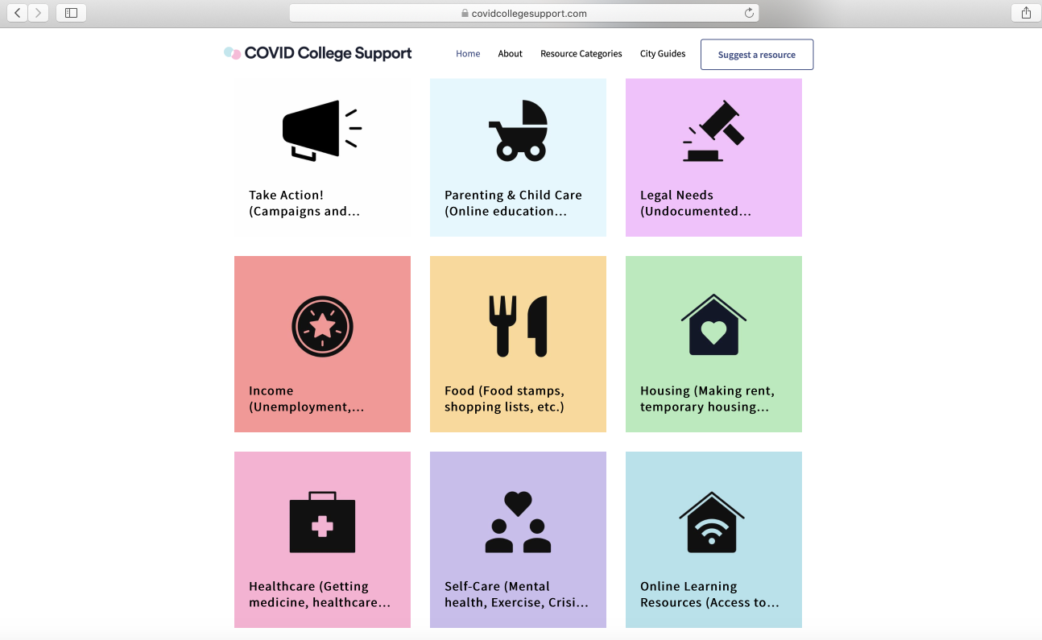

COVIDCollegeSupport.com
Support across
basic needs categories
Localized guides,
made for and by students
Offered by Edquity, an emergency aid company

Slide 26
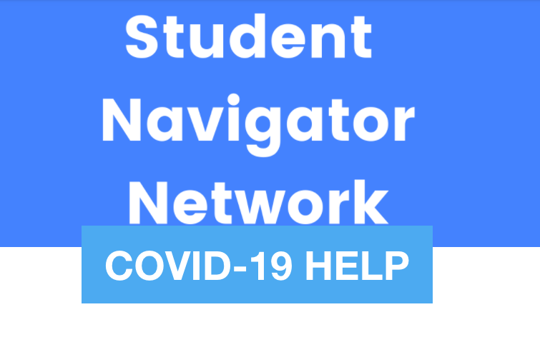
RiseFree.org/Covid-19-Help
Connect with a case manager
Students support students
Offered by Rise, a non-profit & advocacy org

Slide 27

Think Flexible
Offer both synchronous and asynchronous virtual support
Help them focus on their growth> absolute standards

Slide 28

Deploy Emergency Aid Equitably
Speed is key, but the pandemic is ongoing
“First come first served” is not equitable
You can braid funding streams to serve non-FAFSA filers
Don’t make students perform their poverty
Put applications online and advertise widely
See detailed guides on the Hope website

Slide 29

Supplement Emergency Aid
Tell all students how to file for unemployment insurance
Connect them to public benefits, including SNAP, EITC, and Medicaid
Provide navigational support

Slide 30
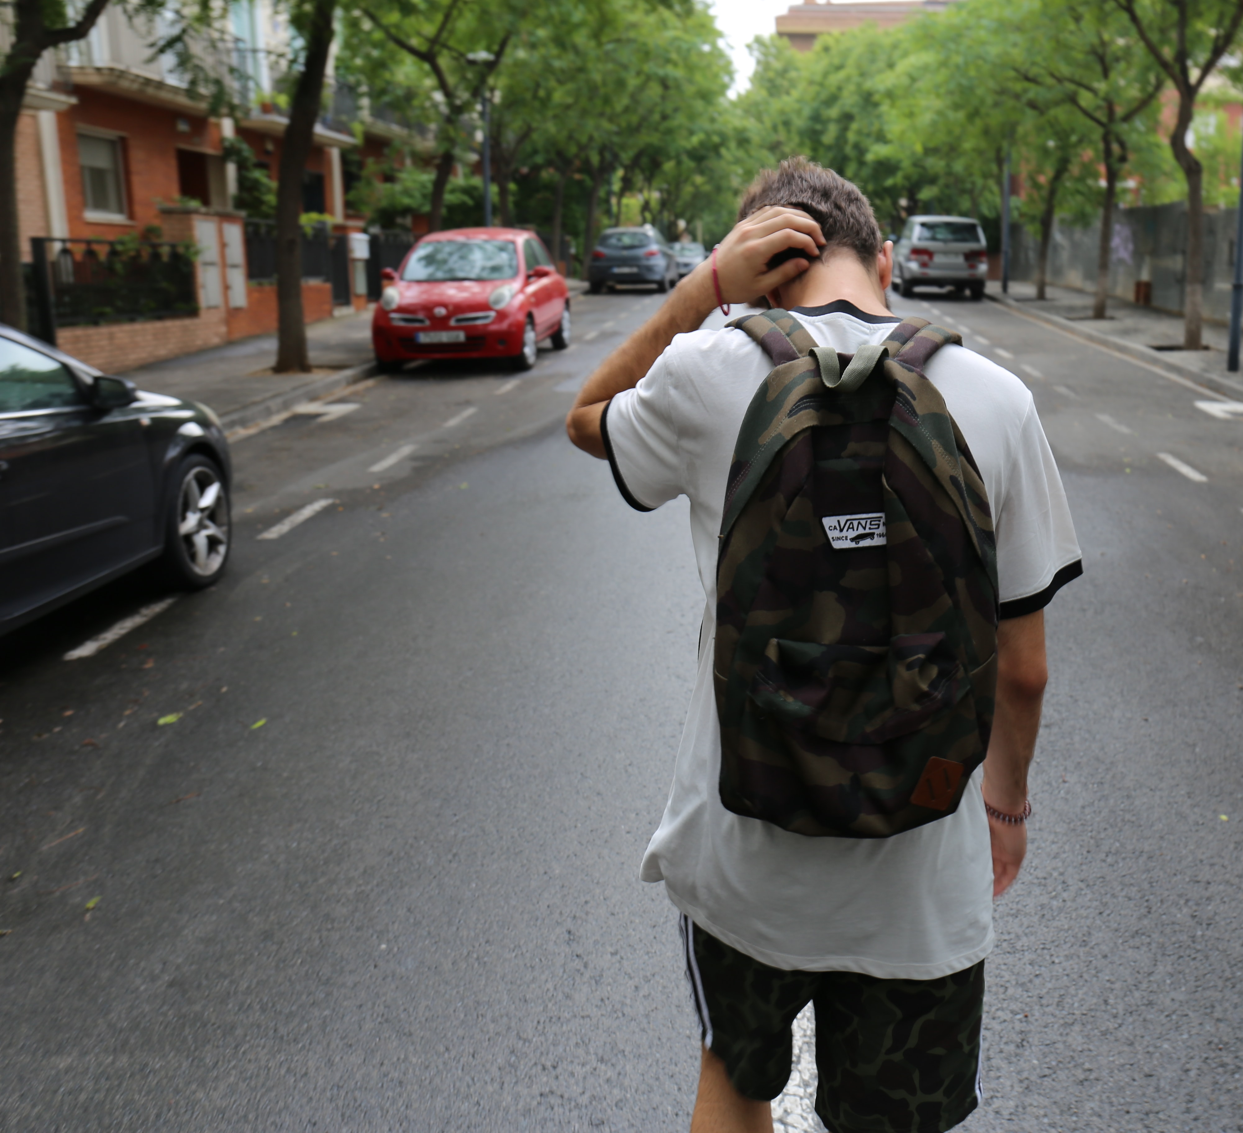
Support the Humans
Affirm that they are not alone
Be human with them; share your struggles at appropriate times
Provide support for anxiety: normalize it, offer perspective, shift the spotlight, encourage distraction, manage your own

Slide 31

Advocate
Include students in stimulus payments and unemployment
Increase emergency aid funding
Suspend SNAP work requirements
Support institutions to expand services and improve teacher working conditions
Make public higher education free

Slide 32

PPT TEMPLATE END.jpg

